Slide 1




Agentic AI for MATLAB & Simulink
Engineering and research work an agent can actually run
Seminar + live demo · 2 hours · built and verified on MATLAB R2026a
A live demo first · the toolkits in detail · a main demo end to end · safety-critical C to close
Koay Xian Cong · Application Engineer · Techsource Systems Pte Ltd
Prepared for the AUMOVIO–NTU Corporate Lab and NTU EEE
Notes:
Welcome. Two hours: roughly 25 min on why, 15 on the stack and Simulink, 55 on the two live demos, 25 on skills and wrap. Setup is in the appendix.
BEFORE YOU START: run /usage and show the room your token count. You will show it again after every demo checkpoint - the point is how little this costs.

Slide 2
Agenda — 2 hours
1
See it first — a live demo
10 min
Predict when a machine will fail, built in front of you
2
Why agentic AI, and why MathWorks
25 min
Copilot vs agents · MCP · what stays your responsibility
3
The toolkits, in detail
20 min
The stack · eight model tools · skills · guardrails
4
The main demo, end to end
45 min
Build a plant and controller · requirement → failing test → green
5
Safety-critical code, then wrap
20 min
Polyspace on ECU C · resources · Q&A
Techsource Systems · Agentic AI for MATLAB & Simulink
2
Notes:
Set expectations: this is a demo-led session, not hands-on. Setup section is included so you can repeat it on your own machine tonight.

Slide 3
The copy-paste loop is broken
You cannot paste a Simulink model — or a 400 MB test log — into a chat window
Chat AI — you are the middleware
Agentic AI — the agent runs the loop
you retype the problem
you state the goal
you paste the error back
it answers, untested
it fixes and re-runs
the agent plans
it breaks
you paste it into MATLAB
it reads the real error
it runs MATLAB itself
every lap costs you a context switch
you step in to review, not to relay
!
What the left loop costs you
✓
What the right loop gives you
Hallucinated block names and library paths that do not exist
Advice that arrives untested — you rebuild it by hand to find out
The agent reads and edits the real model, then simulates it
Reviewable evidence: tests that ran, numbers you can check
LLMs hallucinate models and mathematics. MATLAB executes them. Execution inside the real tool is what makes AI trustworthy for engineering.
Source: MathWorks — Guide to Agentic AI with MATLAB and Simulink, Ch. 2
Techsource Systems · Agentic AI for MATLAB & Simulink
3

Slide 4
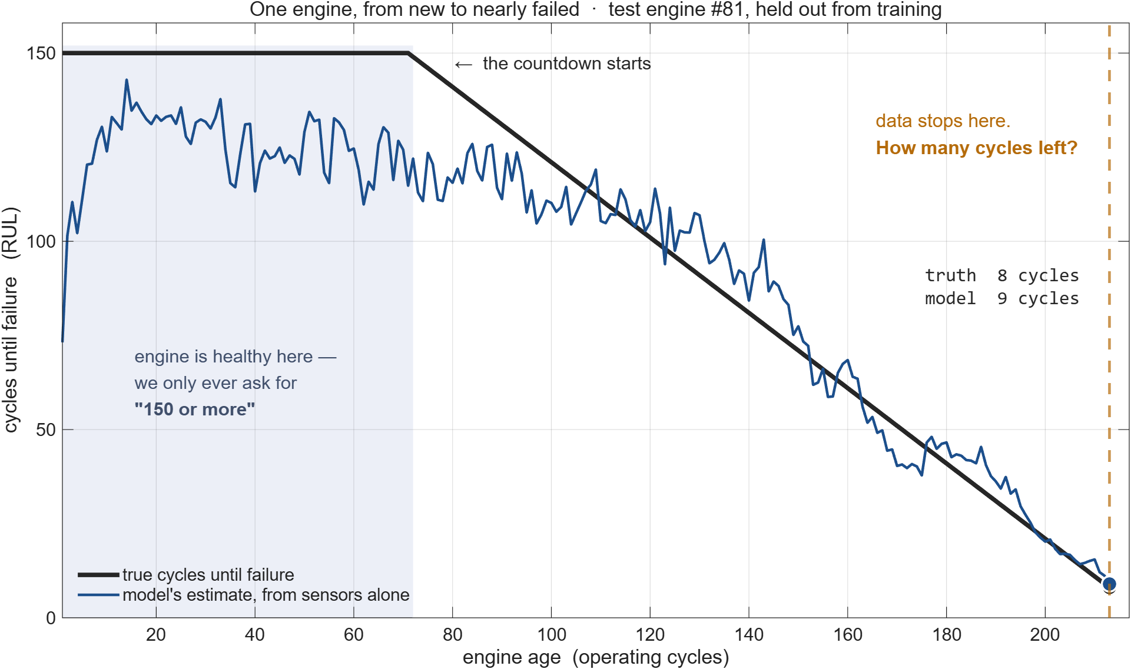
What we are predicting: cycles until failure
DEMO
One held-out engine, from new to nearly failed — and the question the model has to answer
What RUL means
Every engine in this data ran until it actually failed.
RUL = the cycles left at any moment — a countdown to failure.
Capped at 150: past that, a healthy engine looks much the same.
For a test engine the data just stops. From sensors alone — how many cycles remain?
ACROSS ALL 100 HELD-OUT ENGINES
typical miss (RMSE)
~20 cycles
half the engines within
11 cycles
vs guessing the average
half the error
Given sensor readings alone, it has to say how many cycles are left. On this engine: 8 actual, 9 predicted.
Show /usage BEFORE the first prompt — write the number down.
Techsource Systems · Agentic AI for MATLAB & Simulink
4
Notes:
WHAT THIS SLIDE IS FOR
Establish the problem before showing any result. Nobody can read a predicted-vs-actual plot until they know what RUL is.
TALK THROUGH THE FIGURE, LEFT TO RIGHT
- Black line: the truth. Every engine in this data ran to failure, so the number of cycles remaining is known at every point - it counts down to zero.
- Flat top / shaded region: the 150 cap. Early in life a healthy engine looks the same whether it has 200 or 300 cycles left, so everything above 150 is labelled just '150 or more'. Without the cap you train on noise.
- Blue line: the model's estimate at each cycle, from sensor readings only. It is noisy early (little signal in a healthy engine) and tightens as wear shows.
- Amber dashed line: where this engine's data stops. THAT is the actual task - one number, at that moment. Truth 8 cycles, model said 9.
This is engine #81, held out from training. One engine of 100 - the aggregate numbers in the box are across all of them.
IF ASKED HOW IT DOES ACROSS THE RANGE (measured, rng 1)
50 or fewer cycles left n=33 RMSE 12.6 bias +5.8
50 to 100 n=33 RMSE 27.4 bias +15.2
100 or more n=34 RMSE 16.4 bias +1.7
Positive bias = it claims more life than there is, the risky direction. Of the 25 engines with 30 or fewer cycles left it called 20 late, by about 6 cycles. Mid-life is the weakest band. RMSE varies 19-21 run to run on random init.
A REPRODUCIBILITY POINT WORTH MAKING IF IT COMES UP
An earlier version of this demo said 'scale the sensors' rather than 'normalise the dataset'. That one word left the training targets unscaled, and the model then never predicted beyond about 99 cycles - it could not reach the top of the range at all. Same prompt structure, same architecture, materially different model. Nobody would have caught it from the agent's output; it took plotting this curve. That is the human-in-the-loop argument in one example.

Slide 5
Demo · the two prompts that did it
DEMO
~8 min · NASA turbofan run-to-failure data, published by MathWorks — and it trains live
TWO PROMPTS — ONE AT A TIME
1 Using Turbofan dataset from MathWorks, download it to turbofan/
Then tell me what is in train_FD001.txt and which sensors carry
no information before you model anything.
2 Now predict the remaining useful life. For each engine, work out how many
cycles it had left at every row and cap it at 150.
Normalize the dataset.
Then train an LSTM (100 units, 20 epochs, 0.01 learning rate)
Evaluate on test_FD001 against Mathworks' ground truth
Plot predicted vs true
Explain each choice
3 Explain the result to me in plain English
Watch for
The data set is public — everyone here can download the same file
It drops 7 of 24 features itself — they are constant, and it says so
The 150 cap is stated, not guessed: past that, healthy engines look alike
One prompt covers prep, training and evaluation — about 15 s end to end
Evaluation is against MathWorks' held-out ground truth, not its own split
MCP TOOLS CALLED
SKILLS TRIGGERED
PRODUCTS REQUIRED
evaluate_matlab_code run_matlab_file
matlab-train-network matlab-analyze-data
DEEP LEARNING TOOLBOX
Measured on the shared session: 17 features kept · trains in 8–16 s · RMSE ~20 cycles on 100 unseen engines.
Data: NASA C-MAPSS turbofan degradation set, from the MathWorks “Data Sets for Deep Learning” page — public, and already cached locally
Techsource Systems · Agentic AI for MATLAB & Simulink
5
Notes:
Open the MathWorks “Data Sets for Deep Learning” page on screen before prompt 1. The point: MathWorks publishes this data, everyone in the room can pull the same file today.
The prompt says “if it is not already there” on purpose. It IS already there, so the agent finds the local copy and skips the download - you get the provenance without gambling on the network in front of 100 people.
WHAT PROMPT 2 IS ACTUALLY ASKING FOR - narrate this while it runs
1. The raw file has no “remaining useful life” column. It has one row per operating cycle per engine, running until that engine failed. So the countdown has to be computed: an engine that lasted 192 cycles had 191 left on row 1, 92 left on row 100, 0 at the end.
2. The 150 cap: a brand-new engine with 300 cycles left looks identical to one with 200 left - nothing in the sensors separates “very healthy” from “very healthy”. Everything above 150 is labelled just “150, plenty of life”. Without the cap you train on noise. This cap is also why predictions ceiling out near 99 on the previous slide.
3. Scaling: the 21 sensors have different units - temperatures in the hundreds, pressures near 1, fan speeds in the thousands. Raw, the big-numbered sensors dominate training. Subtract each sensor's mean, divide by its spread - computed on TRAINING data only, then reused on test. Using test statistics would be leakage, and it is worth saying so.
WHY THE TRAINING SETTINGS ARE PINNED
100 units, 20 epochs, learn rate 0.01 is what produces the RMSE ~20 on the previous slide. In rehearsal 12 epochs gave RMSE 51. Left unspecified the agent picks its own, and the number on the slide stops matching the room. Say it plainly if asked: an engineer specifies the architecture.
RMSE varies run to run (random init): expect roughly 20-27 cycles.

Slide 6
What makes an agent an agent
Four capabilities — and one loop that ties them together
Reasoning
Planning
Tool use
Adaptation
Breaks your problem into sequential, checkable steps
Orders actions toward the goal — and shows you the plan first
Calls MATLAB and Simulink through MCP — real execution, not prose
Reads errors and results, corrects itself, tries again
THE ONE-GLANCE MODEL
You
›
AI agent
›
LLM
›
MCP → MATLAB / Simulink
›
You
set the goal and limits
coordinates the task
proposes — it never runs tools
tools act, results return
review the evidence
AND WHAT IT STILL CANNOT DO — WHICH IS WHY YOU ARE IN THE LOOP
!
No physical intuition
It cannot set the pass mark
It does not know your conventions
It will build a model that runs and is nonsense. Main demo A shows exactly this.
You own the acceptance criteria. Otherwise it grades its own homework.
Until you write them down as a skill — Part 4.
The agent coordinates; the LLM proposes; tools act; you review.
Source: MathWorks “Agentic AI 101”
Techsource Systems · Agentic AI for MATLAB & Simulink
6

Slide 7
Two different things — and you want both
An assistant sits inside the product. An agent drives it from outside.
AI ASSISTANTS
AGENTIC WORKFLOWS
Generative AI, in the product
Agentic AI — today’s session
MATLAB Copilot · Simulink Copilot · Polyspace Copilot
Inside the window you already work in.
Suggests code, explains an error, drafts a diagram.
It proposes one step. You accept, edit or reject it.
You run it, and you hold the whole loop in your head.
MathWorks products, licensed separately.
Your agent + the MATLAB and Simulink Agentic Toolkits, over MCP
Outside MATLAB, driving the session you have open.
Plans, calls a tool, reads the real result, corrects itself.
It runs the work, tests it, and hands you the evidence.
It holds the loop; you hold the goal and the pass mark.
Works with the agent you already use.
WHERE EACH ONE FITS
Assistant — while you are typing: a faster keyboard and a second pair of eyes.
Agent — when the task is a whole loop: build it, run it, test it, fix it, prove it.
Copilot writes with you. An agent works for you — and shows its evidence. Today is the second one.
Framing: MathWorks · “Agentic AI Workflows with MATLAB and Simulink”
Techsource Systems · Agentic AI for MATLAB & Simulink
7
Notes:
Say: both are useful and they are not competitors.
MATLAB Copilot and Simulink Copilot are MathWorks products - generative AI built into the IDE. You stay at the keyboard; it accelerates the keystroke.
Agentic AI is the other axis: an external agent (Claude Code, Codex, Copilot agent mode) that reaches into your live MATLAB session through MCP and performs whole loops - build, simulate, test, diagnose, fix, re-verify.
The rest of today is the second one, because that is the part that changes what a single researcher can get through in an afternoon.

Slide 8
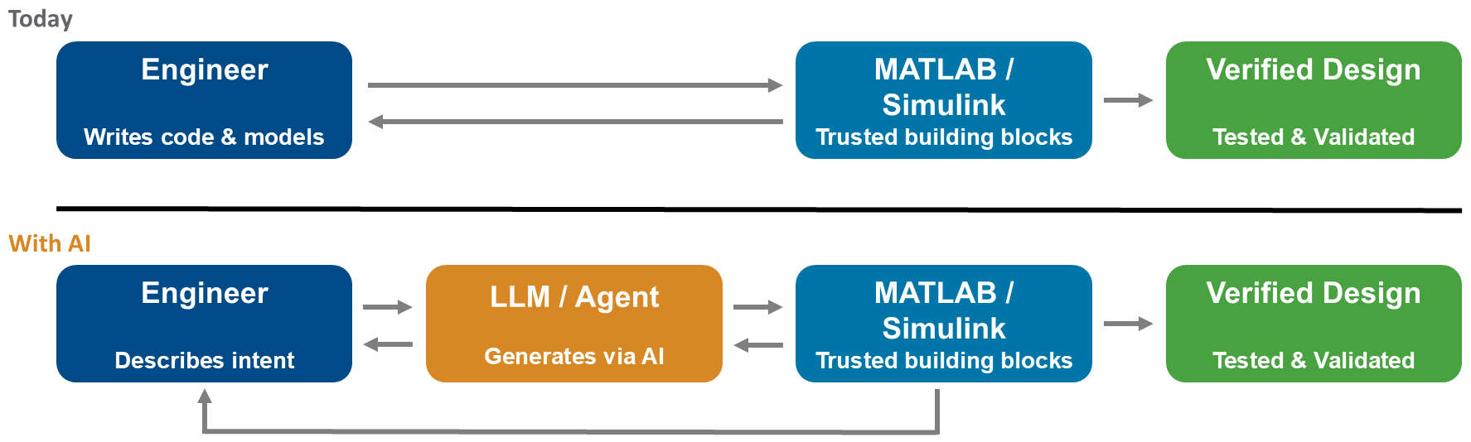
Agentic AI changes how you create, not accountability
The trusted building blocks and the verification evidence are the same in both rows
Diagram: MathWorks · “Agentic AI Workflows with MATLAB and Simulink”
✓
Numerics you already trust
Qualifiable for certification
The agent cannot fake a result
Forty years of validated solvers, filter design, linear algebra and physical modelling — the same tools your papers already cite.
IEC Certification Kit and DO Qualification Kit exist precisely so this toolchain can be used under ISO 26262, IEC 61508 and DO-178.
Every number in this deck came out of a solver or a static analyser. An LLM on its own can only produce a plausible-looking one.
The engineer owns the design. The same engineering evidence verifies it.
Techsource Systems · Agentic AI for MATLAB & Simulink
8
Notes:
This is the slide for the sceptic in the room. The argument is not "trust the AI" - it is that the AI is never the thing being trusted. The solver is, and it was already trusted before any of this existed.

Slide 9
Why MathWorks with agentic AI?
Three ways the same objection arrives — and the answer to all three
YOU WILL BE ASKED
✓
1 · Trusted building blocks, not blank-page generation
2 · Agentic AI accelerates creation. MathWorks, verification.
3 · Agents get better when the tools are domain-specific
Thousands of functions — the backslash operator A\b among them — encode decades of numerical and domain expertise as deterministic decision trees.
Correct, efficient and consistent every time. An LLM may reach the same answer some of the time; it cannot guarantee it every time.
Less surface area for hallucination, and less surface area for you to verify.
Together they deliver what neither can alone: speed AND trust.
Without traceability and a verification framework you are only generating code faster — with no way to know whether it is correct.
Speed is worthless if nobody can sign it off.
Without the toolkits, a frontier model burns tokens working out how to do engineering — instead of doing the engineering.
With them, frontier models go from good to excellent.
From general-purpose coders to effective engineering assistants.
Agentic AI makes you faster. MATLAB and Simulink make you right. The combination is the whole argument.
Techsource Systems · Agentic AI for MATLAB & Simulink
9
Notes:
STANDARD RESPONSE - full wording, for Q&A.
1. Trusted building blocks, not blank-page generation. MATLAB has thousands of functions - like the backslash operator (A\b) - that encode decades of numerical and domain expertise in deterministic decision trees, guaranteeing answers that are correct, efficient, and consistent. An LLM may produce the same answer some of the time, but it has no guarantee to do so every time. By building on top of a trusted foundation, you reduce the surface area for hallucinations by agents, and reduce the surface area for verification by engineers.
2. Agentic AI accelerates creation. MathWorks tools accelerate verification. Together they deliver what neither can alone: speed AND trust. Without traceability and a verification framework, you're just generating code faster with no way to know if it's correct.
3. Agents become more effective with domain-specific tools. Without MATLAB and Simulink plus the Agentic Toolkits, frontier models spend tokens figuring out how to perform engineering tasks instead of doing the engineering. With the toolkits, frontier models go from good to excellent - turning agents from general-purpose coders into effective engineering assistants.

Slide 10
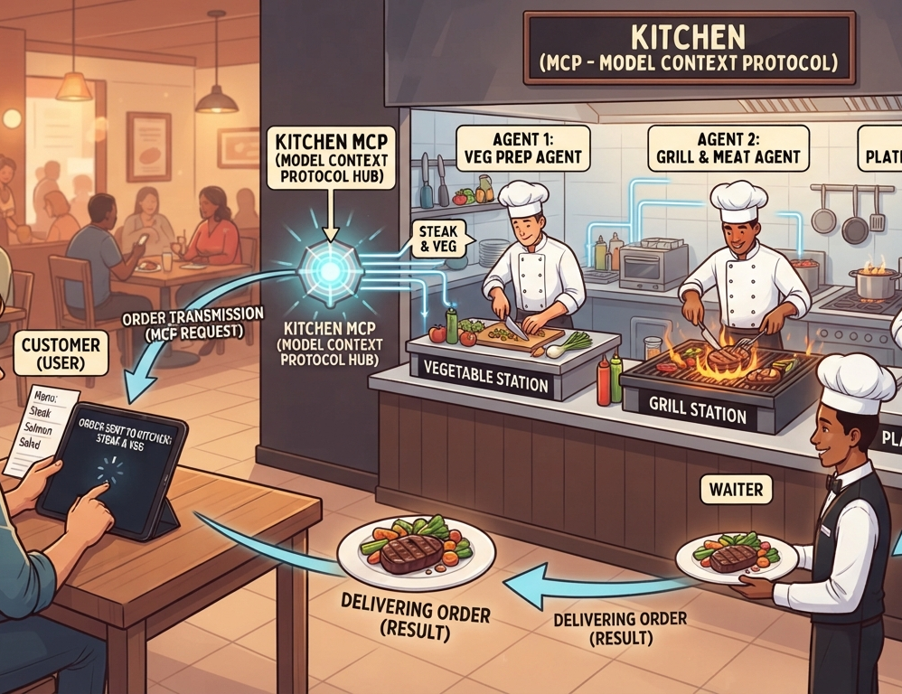
MCP and skills — the restaurant analogy
The chef coordinates, the rail carries, the line cooks — and nothing leaves the pass unless you approve it
✓
MATLAB
Simulink
tests
You order
The ticket rail
The chef
The line
You taste it
= your prompt
= MCP
= the AI agent
= MATLAB + Simulink
= your review
approve — or send it back
The recipe book = skills
And the LLM?
Why the analogy matters
Proven procedures per dish — opened only when that dish is ordered
Consistent quality, no improvising on your model
The chef's culinary knowledge — it proposes what to cook next
It never touches the stove. Any LLM works.
Swap the ordering app — Claude Code, Copilot, Codex, Gemini
Same kitchen, same recipes, same result
The rail does not cook and the app does not cook. MCP is plumbing; the agent is the one making decisions — and you taste every plate.
Mapped to MathWorks' “Agentic AI 101”: the agent coordinates; the LLM proposes; tools act; you review.
Techsource Systems · Agentic AI for MATLAB & Simulink
10

Slide 11
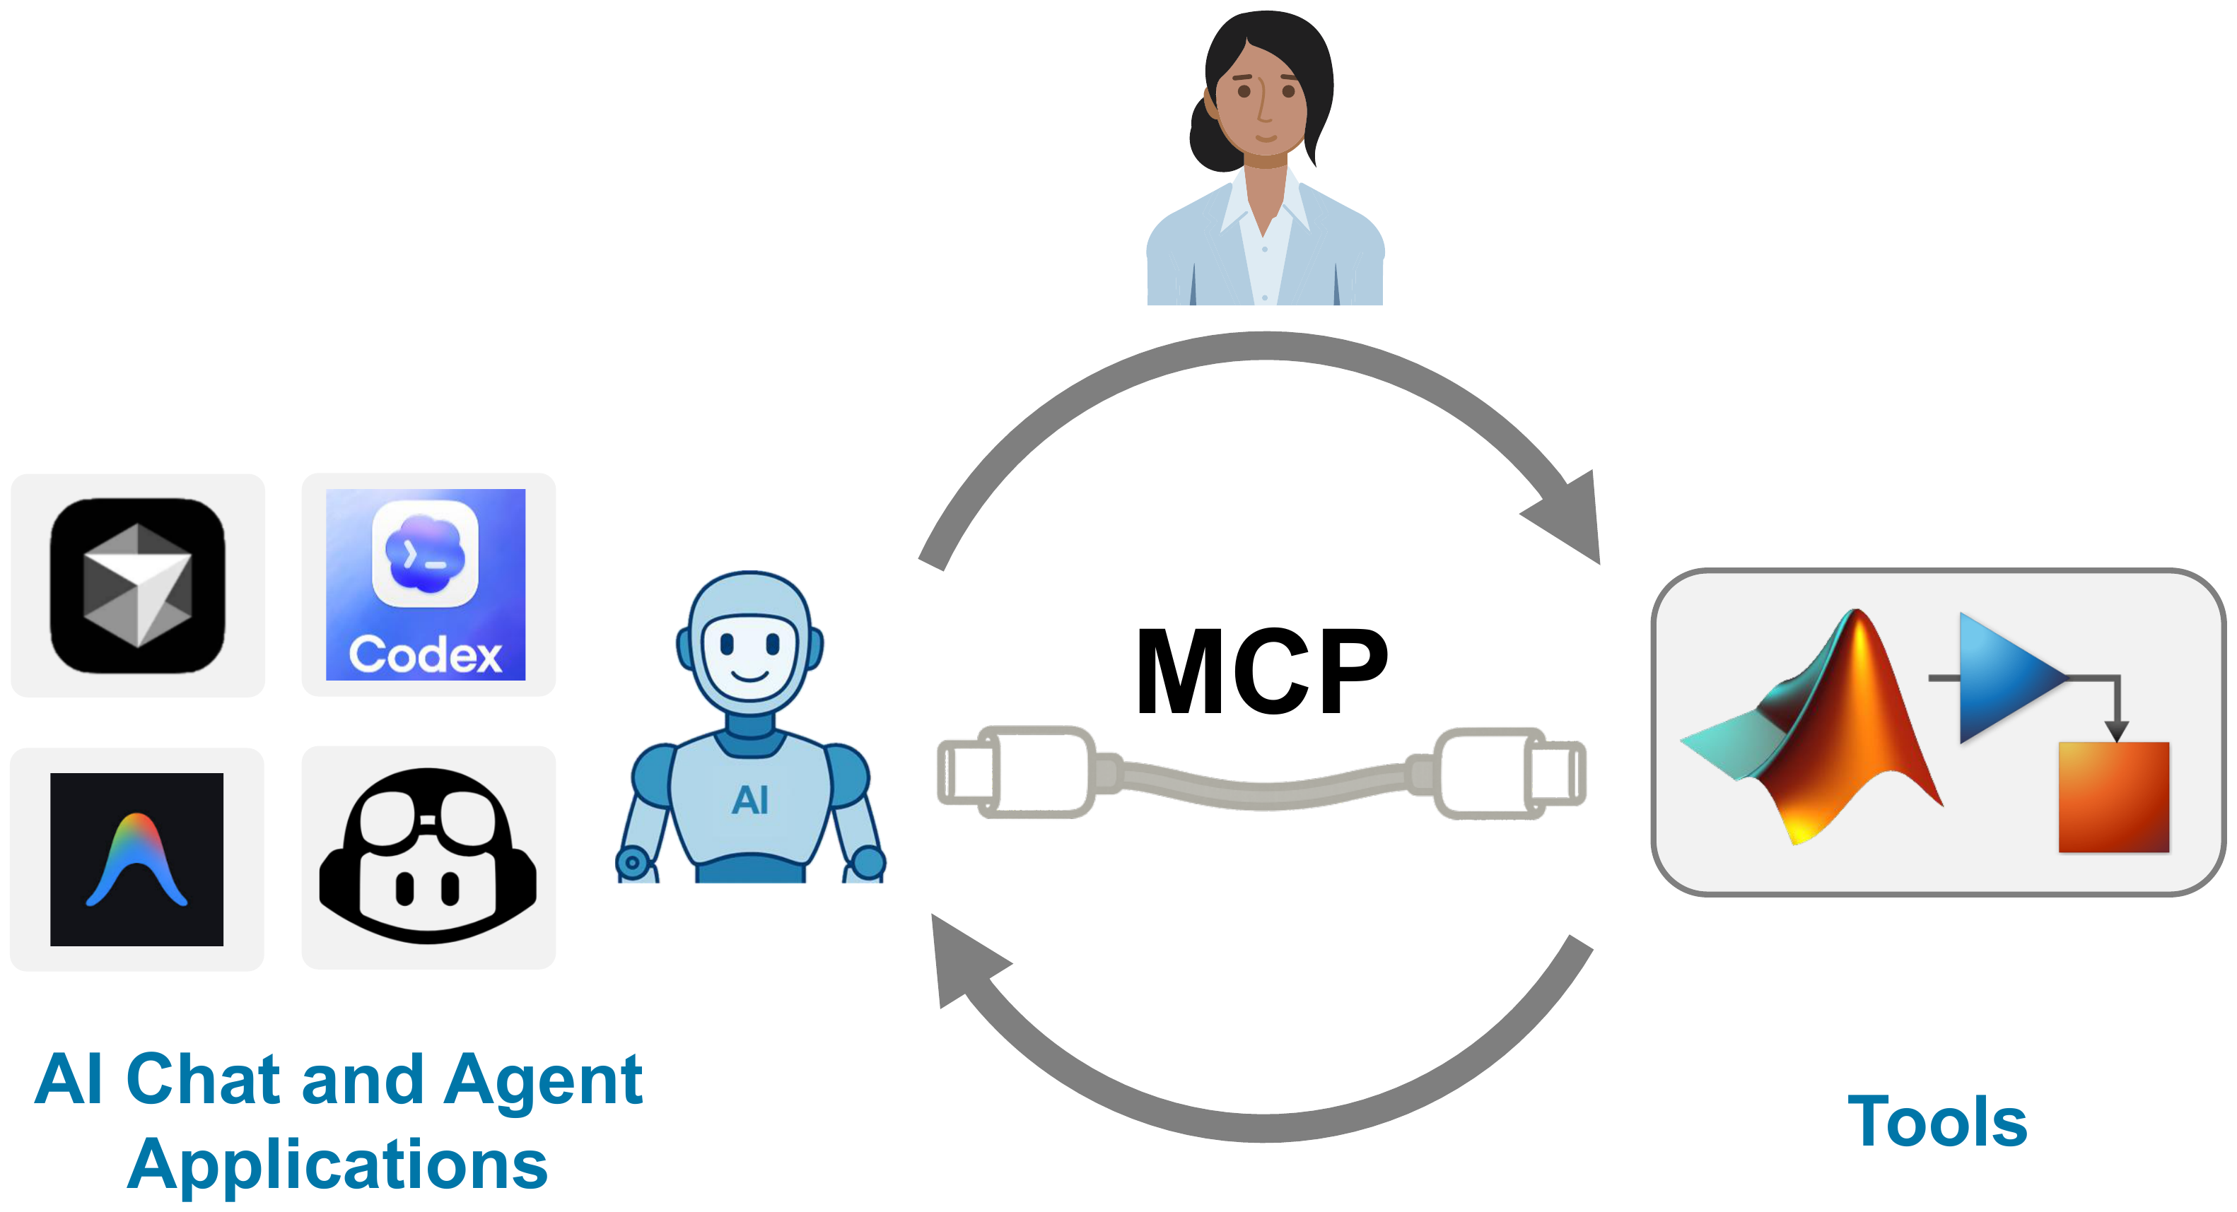
MCP — the connection between AI agents and MATLAB
An open protocol. Think USB-C for AI tools: one connector, any agent, any trusted tool.
Diagram: MathWorks · Techsource regional webinar deck
The chat window and the compute are now separate
And you stay above the loop
Change your agent without changing your tools — or the reverse
The human sits at the top of the diagram for a reason
One standard connector. The tools on the right are the ones you already validate your work with.
Techsource Systems · Agentic AI for MATLAB & Simulink
11

Slide 12





It works with the agent you already use
One MCP server, one configuration pass — the toolkit is agent-agnostic and LLM-agnostic
SHIPS WITH A READY-MADE TEMPLATE
AMP
Claude Code
GitHub Copilot
OpenAI Codex
Gemini CLI
Amp
CLI · Desktop · IDE
VS Code, agent mode
CLI · Desktop app
as an extension
Sourcegraph
AND ANYTHING ELSE THAT SPEAKS MCP — TESTED ON THIS MACHINE, NOT AN OFFICIAL LIST
Not on the list? It still works
And it runs on local models
The MATLAB MCP Server is a plain local binary. Any MCP-capable client can be pointed at it — there is nothing special about the five above.
Tested here: Cursor · Mistral Vibe
The LLM is a separate choice from the agent. Put an open-weights model on your own hardware and nothing leaves the building.
Tested here: Ollama · LM Studio
Logos are trademarks of their respective owners, shown to indicate compatibility · sources on the credits slide
MCP is an open protocol. If your agent speaks it, the MATLAB tools are already available to it.
Techsource Systems · Agentic AI for MATLAB & Simulink
12
Notes:
The five logos ship a template, so setup is one command. Everything else just needs the server registered by hand - same binary, same skills. Say plainly that Cursor, Mistral Vibe, Ollama and LM Studio are OUR tests, not MathWorks' supported list. That honesty is why people believe the rest of the deck.

Slide 13
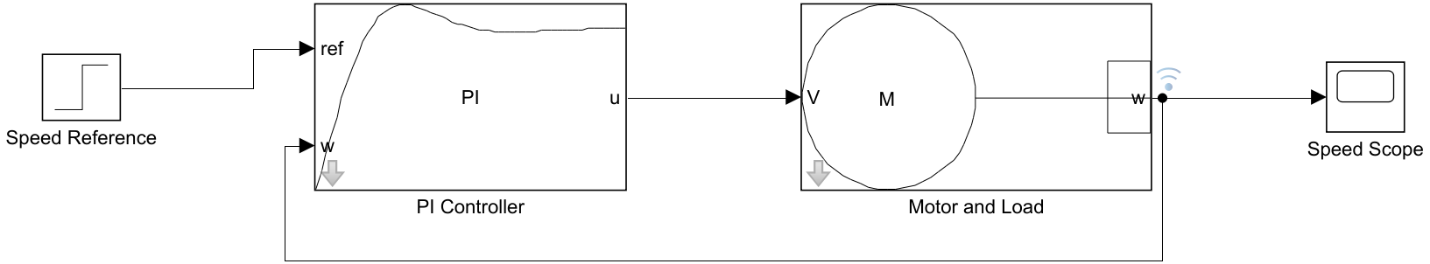
First — what is Simulink?
For the half of the room who live in .m files: this is the other half of MATLAB
In one sentence
MATLAB computes on data you already have. Simulink simulates how a system behaves over time — before the hardware exists.
The model you are about to watch the agent build.
You draw it, not type it
Several physics at once
Change it and re-run
The model is the spec
Blocks and signals instead of a differential-equation solver you wrote yourself.
Electrical, mechanical and thermal in one model — that is Simscape.
A design sweep is a loop, not a rebuild. No rig, no lab booking.
Requirements, tests and embedded C all come off the same diagram.
MATLAB is where you compute. Simulink is where you model behaviour over time.
Techsource Systems · Agentic AI for MATLAB & Simulink
19
Notes:
Keep this to about ninety seconds. Ask for a show of hands: who has opened Simulink this year? In an EEE room it is usually under half, and the rest need this slide before the demo will land.

Slide 14
PART 4 · 45 MINUTES · LIVE DEMO
The main demo, end to end
Small prompts · plan first · pause at every checkpoint · demand evidence
Built and timed on R2026a
Agent connected
Show /usage at every step
Techsource Systems · Agentic AI for MATLAB & Simulink
26
Notes:
SHOW /usage BEFORE YOU TYPE THE FIRST PROMPT. Write the number on the whiteboard. You will come back to it at the end - the whole session costs less than people expect.

Slide 15
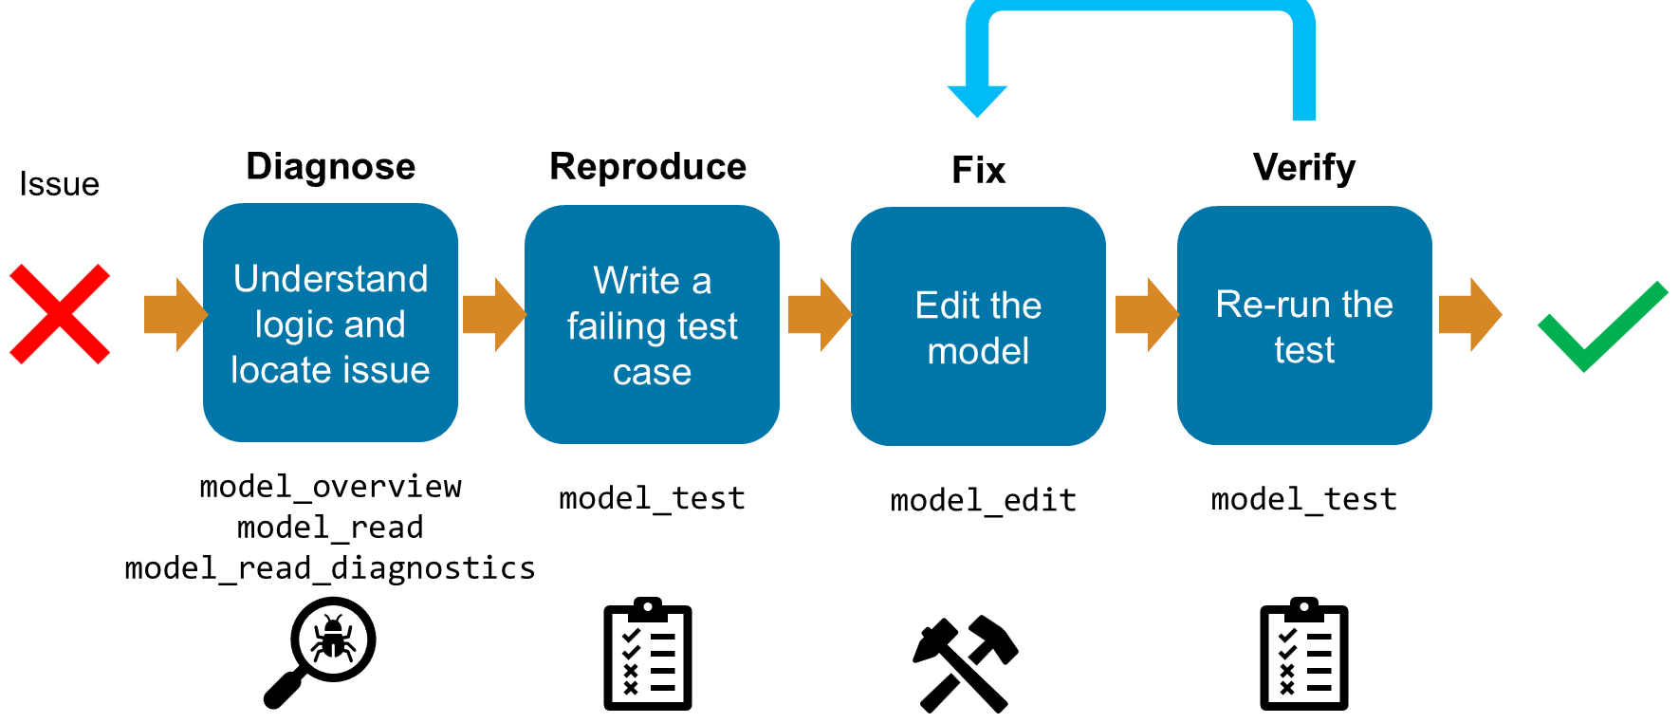
The loop you are about to watch
DEMO METHOD
Troubleshoot → fix → verify, with the tool the agent calls at each step
Diagram: MathWorks · “Agentic AI Workflows with MATLAB and Simulink”
Main demo A is exactly this loop
✓
Note the order
A requirement, a failing test, a fix, and a re-run that proves it
The failing test comes before the fix — otherwise nothing is proven
The agent never decides whether the test is the right test. You do.
Techsource Systems · Agentic AI for MATLAB & Simulink
27

Slide 16
How to drive the agent — and what to show the room
DEMO METHOD
The discipline that turns a demo into a method people can copy
Frame
Plan first
Checkpoint
✓
Evidence
Scope one small, testable task. Name the files, the goal, the limits.
“Ask me questions before you build.” Approve or redirect.
“Pause after each stage.” Review in Simulink, not in the chat.
Accept nothing without artifacts: a run, a test, a plot, a diff.
SHOW YOUR USAGE — BEFORE, AND AT EVERY CHECKPOINT
Type /usage before the first prompt, and again after each demo. The room sees the real cost of an agent that runs the tool instead of guessing at it.
This is the argument for the toolkit: local skills and scoped tools mean fewer round trips, fewer tokens, and fewer wrong turns than a generic agent web-searching block names.
Say this out loud
And always
“I am not checking whether the AI is clever. I am checking whether it is right.”
“Everything it just did, I can read, run, and revert.”
git init before the agent edits anything — its output becomes a reviewable diff
Commit at each accepted checkpoint; that history is your audit log
Treat the agent like a capable new colleague: clear brief, visible plan, reviewed output.
Techsource Systems · Agentic AI for MATLAB & Simulink
28

Slide 17
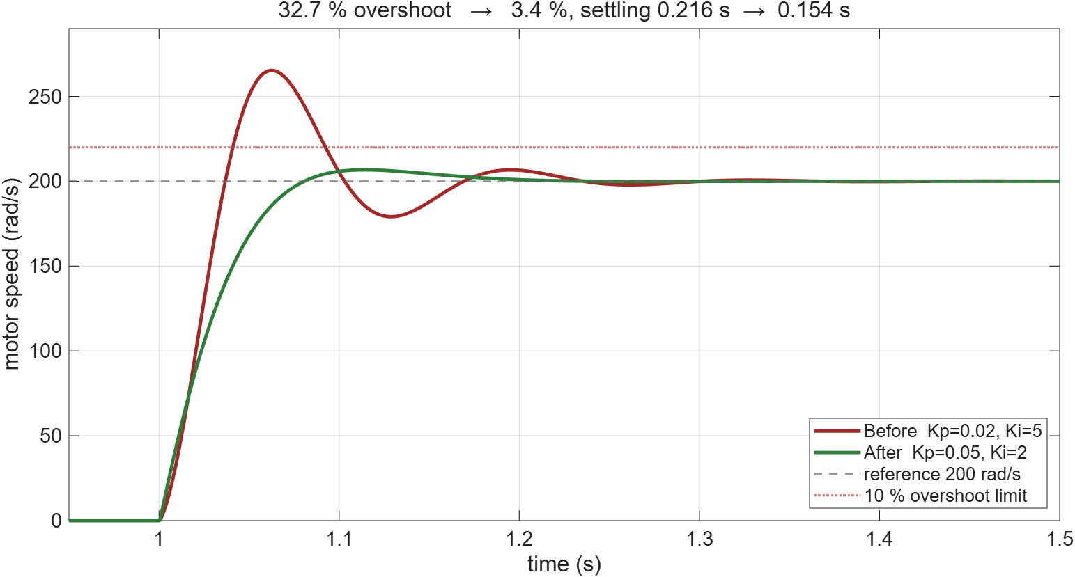
Main demo A · where we are going to end up
MAIN DEMO A
The requirement, met. Red breaches the 10 % overshoot limit; green does not.
Where this ends: 32.7 % → 3.4 % overshoot, settling 0.216 s → 0.154 s. Nothing is built yet — the agent earns this plot over five prompts.
Run /usage now — and again at every checkpoint.
Techsource Systems · Agentic AI for MATLAB & Simulink
29

Slide 18
Main demo A · Build the plant and the controller
MAIN DEMO A
~10 min · five small prompts, a pause after each — architecture before blocks
PROMPTS — ONE AT A TIME, PAUSE BETWEEN EACH
1 I want to model a DC motor with PI speed
control in Simscape. Before you build
anything, ask me the questions you need
answered, then show me the architecture view.
2 Build only the electrical side: controlled
voltage source, DC Motor, electrical
reference, solver config. Then pause.
3 Add the mechanical load - inertia, damper,
and a rotational motion sensor. Pause again.
4 Add the PI controller and close the loop.
Simulate 1.5 s with a 200 rad/s step at t=1.
5 (next slide) Restructure into masked subsystems.
Watch for
It asks about motor rating, load inertia and units before touching a block
Blocks appear in YOUR open Simulink — 17 blocks in 2.5 s
Physical connections use <->, Simulink signals use -> ; it knows the difference
R2026a renamed the Step block levels — the agent hits the error, reads the valid names, and fixes itself
MCP TOOLS CALLED
SKILLS TRIGGERED
PRODUCTS REQUIRED
model_edit · model_read model_check · evaluate_matlab_code
building-simulink-models specifying-plant-models · System Composer
SIMULINK + SIMSCAPE ELECTRICAL
Measured on this machine: architecture 4.9 s · 17 blocks 2.5 s · 21 connections 1.1 s · first simulation 4.0 s.
Run /usage now — and again at every checkpoint.
Techsource Systems · Agentic AI for MATLAB & Simulink
30
Notes:
Prompt 1 is the important one - the room should see it ASK, not assume.
After prompt 4 the response looks fine. DO NOT say it worked yet - that is the next slide.

Slide 19
Main demo A · one more prompt to tidy it up
MAIN DEMO A
The agent's first layout is functional and ugly. Ask it to restructure — it costs one prompt.
PROMPT 5 — TIDY IT UP
Restructure this model: put the controller into
a PI Controller subsystem and the plant into a
Motor and Load subsystem. Mask both, give each
a drawn icon and labelled ports, and keep the
behaviour identical - re-run and prove it.
Why bother on stage
A tidy model is what a reviewer will accept
Identical results before and after — the agent proves the refactor was safe
Top level after the restructure: four blocks, drawn icons, labelled ports — and the feedback loop readable at a glance.
Same model, same numbers: 32.7 % overshoot, 200.0 rad/s steady state. Restructuring changed the presentation, not the physics.
Techsource Systems · Agentic AI for MATLAB & Simulink
31
Notes:
Double-click into Motor and Load live - the room should see the blue electrical domain and the green mechanical domain side by side. That is a better reveal than any screenshot.
If you still have the flat version on screen, show them next to each other: same model, one prompt apart.

Slide 20
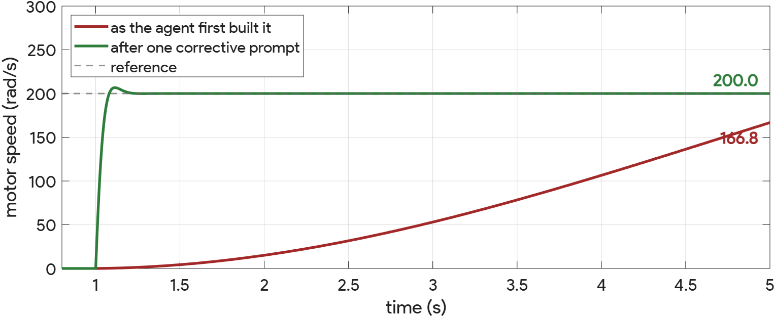
Main demo A · debrief — and it was still wrong
MAIN DEMO A
Nothing errored. The check passed. The simulation ran. It was still physically nonsense.
What it handed me
!
What was actually wrong
The fix — one prompt
A model that compiled, passed model_check, and simulated cleanly
Step to 200 rad/s — after a full 5 s it reached 166.8
It took the DC Motor defaults: a 0.08 W, 1.5 V hobby motor
And the Inertia default: 0.01 kg·m² — a substantial flywheel
No software could know that. It is a modelling judgement.
“Those defaults are physically inconsistent. Parameterise for a ~200 W motor.”
Corrected: 19.9 rad/s per volt, settles in 0.15 s
THIS IS THE ARGUMENT FOR
HUMAN-IN-THE-LOOP
The agent is a fast, tireless junior engineer with no physical intuition. It builds what you ask, correctly, and never notices that the physics is silly. Catching that in four seconds is what your expertise is worth.
I can tell you what the agent did. Only you can tell whether the physics is right — and that is exactly the point.
Run /usage now — and again at every checkpoint.
Techsource Systems · Agentic AI for MATLAB & Simulink
32
Notes:
This is the most important slide in the deck. Do not rush it. It is also the honest one - if you only show successes, engineers stop believing you. Showing the failure and the four-second fix builds far more trust than a flawless demo.

Slide 21
Main demo A · requirement → failing test → green
MAIN DEMO A
~6 min · the loop that makes an agent trustworthy: it must fail first
PROMPT — COPY & PASTE
Requirement: overshoot <= 10% and settling
time <= 0.3 s on the speed step.
Write a test that captures this requirement and
show it FAILING on the current gains. Do not
change the gains before the failing test exists.
Then retune the PI gains until it passes, and
show me the before/after responses as evidence.
Watch for
The failing test comes FIRST — the requirement is now pinned down
The fix is a parameter change, not a rewrite
Numbers come from the executed simulation, not from prose
MEASURED ON THIS MACHINE
Gains
Overshoot
Settling
Verdict
Before
Kp = 0.02, Ki = 5
32.7 %
0.216 s
FAIL
After
Kp = 0.05, Ki = 2
3.4 %
0.154 s
PASS
MCP TOOLS CALLED
SKILLS TRIGGERED
PRODUCTS REQUIRED
model_test · model_edit model_query_params
testing-simulink-models simulating-simulink-models
SIMULINK (+ Simulink Test)
Diagnose → reproduce with a failing test → fix → re-run to green. The agent closes the loop and proves the fix.
Run /usage now — and again at every checkpoint.
Techsource Systems · Agentic AI for MATLAB & Simulink
33

Slide 22
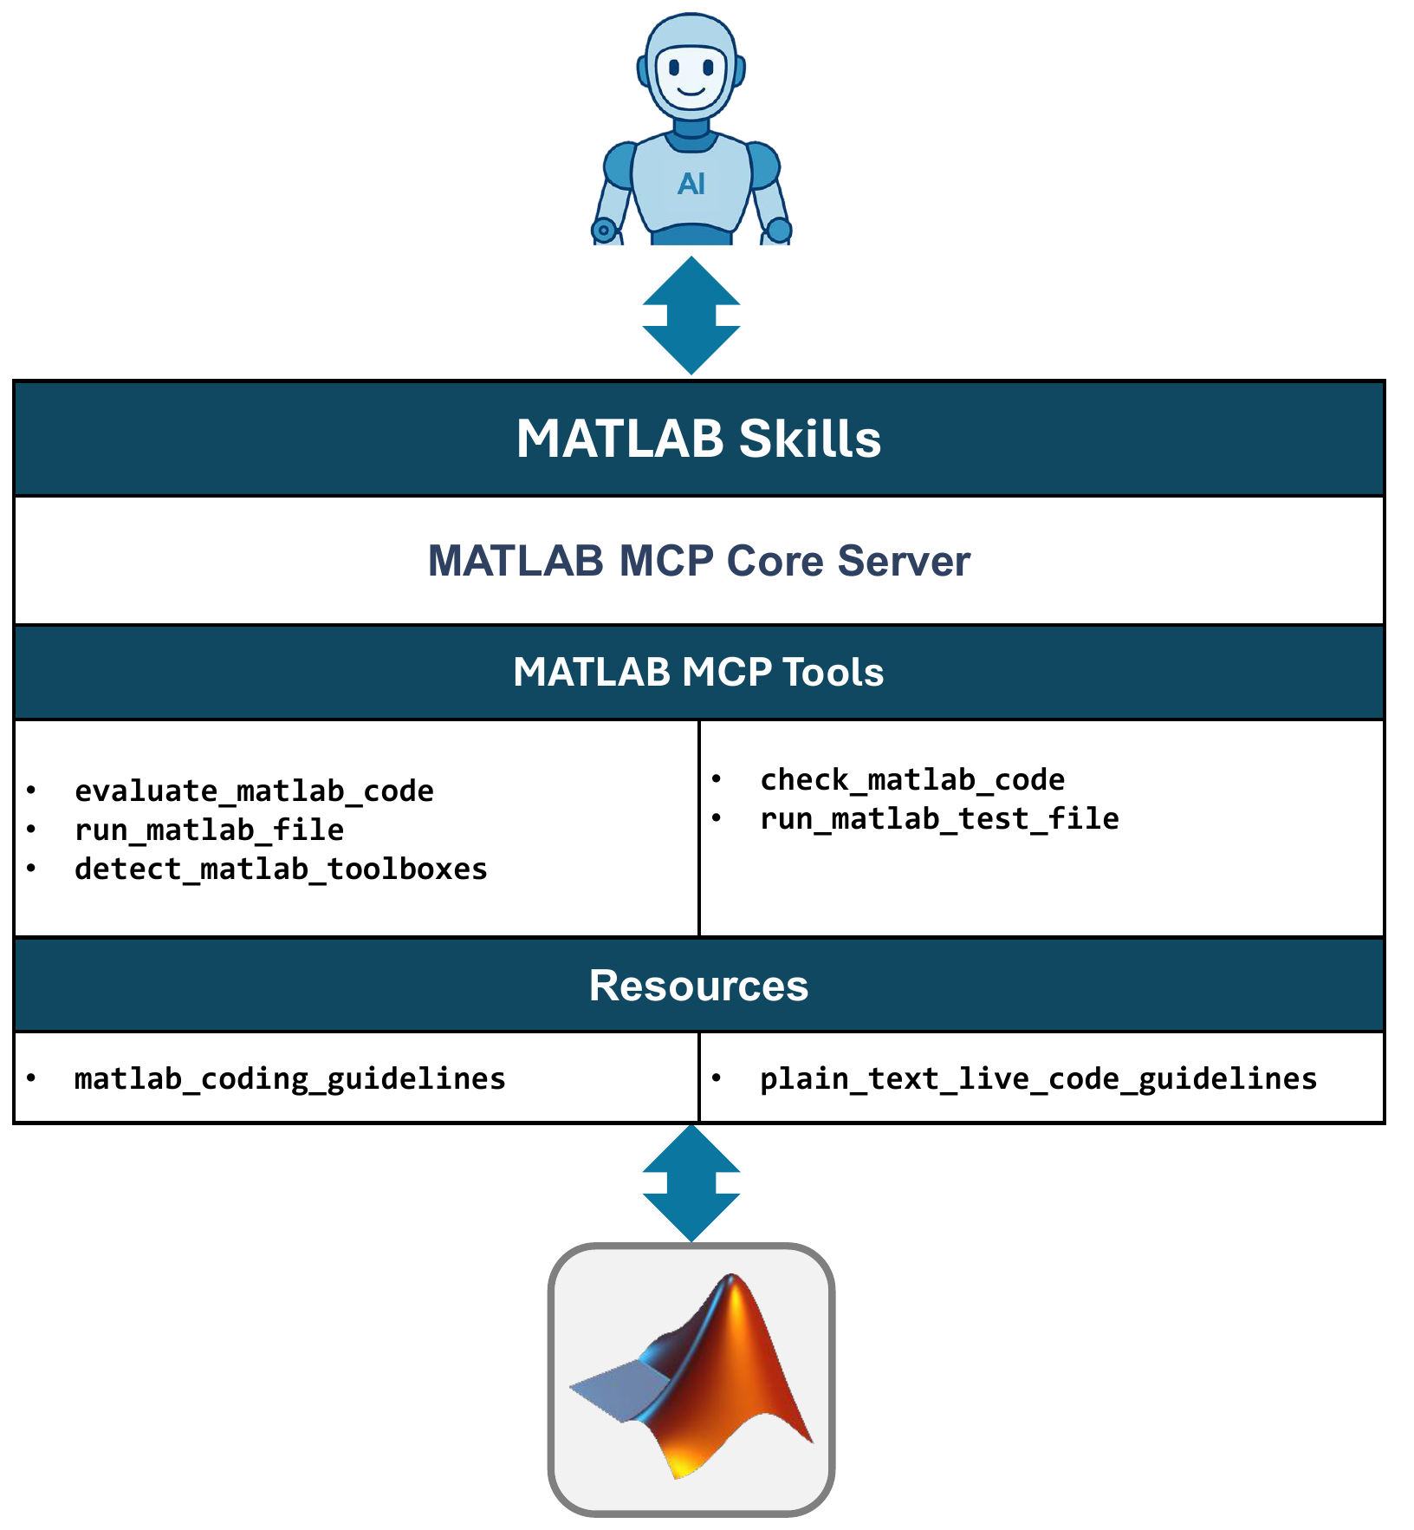
What the MATLAB Agentic Toolkit actually is
Two things: the server that connects, and the skills that guide
1 · MATLAB MCP Core Server
The connection between AI agents and MATLAB — it carries the tools and resources.
A local binary. Your code, models and data never leave the machine.
2 · MATLAB Skills
Guidance on how to approach a task in MATLAB like an expert would.
This is why the agent asked about phase distortion instead of guessing a filter.
155 skills across 25 domains, plus 22 Model-Based Design skills for Simulink.
Diagram: MathWorks · Techsource regional webinar deck
github.com/matlab/matlab-agentic-toolkit — published by MathWorks, and it runs on the MATLAB licence you already have.
Techsource Systems · Agentic AI for MATLAB & Simulink
16

Slide 23
Skills: packaged expertise, loaded on demand
PART 3
Tools do things. Skills know how.
skills/design-digital-filter/SKILL.md
---
name: design-digital-filter
description: when to trigger this
skill - and when not to
---
# Instructions
Correct APIs for this release.
The proven sequence of steps.
Clarifying questions to ask first.
Pitfalls to avoid.
What a skill actually buys you
The right knowledge at the right time — loaded only when the task matches, so hundreds cost nothing until used
Reliability: proven procedures encoded, and grounding against hallucination
Knowledge the model cannot have: your domain conventions and your institutional memory
Without one the agent improvises. With one it asked about phase distortion instead of guessing a filter.
WHAT SHIPS TODAY
MATLAB Agentic Toolkit — 155 skills across 25 domains (automotive, signal processing, AI, RF, test & measurement, code generation)
Simulink Agentic Toolkit — 22 MBD skills across 6 groups (modelling, MBSE, verification, simulation, code gen, control) — updated weekly
Skills tell your agent how to do things correctly the first time around — and a skill is just a markdown file.
Techsource Systems · Agentic AI for MATLAB & Simulink
17

Slide 24
Author your own skill — encode a lab standard
PART 3
The convention you re-explain to every new student becomes something the agent applies every time
PROMPT — COPY & PASTE
Create a skill called ancl-model-standard:
new models use fixed-step ode3 at 1 ms unless
justified; signals on named buses per our
convention; no Goto/From across subsystem
boundaries; every subsystem documented;
every figure exported at 300 dpi with
labelled axes and units.
Use the toolkit skills as a structural template.
Then build any new model and show me it complies.
Good skills are…
Narrow — one workflow, done right
Triggered precisely — the description says when, and when not
Tested — try prompts that should and should not fire it
What labs encode first
{ }
Manage them like code
Modelling conventions: naming, bus structure, solver policy
Review checklists the agent must satisfy before handover
Report and figure formats for papers and deliverables
Keep skills in git next to the project they govern
Keep yours separate from the MathWorks catalog — updates will not overwrite them
One shared repo per lab; layer, do not fork
Rubric checks, data pipelines, naming rules, report formats — institutional memory your agent applies every time.
Techsource Systems · Agentic AI for MATLAB & Simulink
18

Slide 25
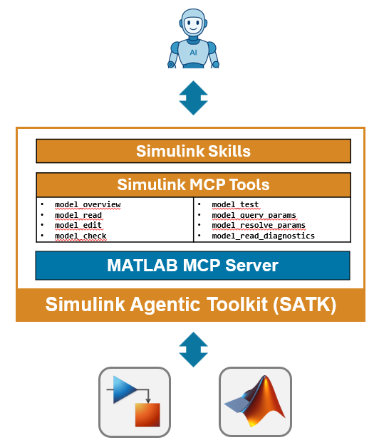
Simulink Agentic Toolkit — the model side
Connect agents to Simulink, giving them both the ability and the knowledge to work with models
Builds on the MATLAB MCP Server
Same binary, same setup. Installing both toolkits is one pass.
MCP tools built for models
Reading, editing, querying, testing and checking Simulink models — eight tools, not raw scripting against a canvas.
Skills that encode Model-Based Design
Model building, plant specification, testing, requirements and architecture modelling — the practice, not just the API.
Diagram: MathWorks · “Agentic AI Workflows with MATLAB and Simulink”
github.com/matlab/simulink-agentic-toolkit — R2023a or later, with Simulink.
Techsource Systems · Agentic AI for MATLAB & Simulink
20

Slide 26
Eight tools that see and touch your model
PART 3
No screenshots, no guessing — structured access to the real thing
model_overview
model_read
Structure summary: subsystems, interfaces, hierarchy
Blocks, parameters, and connections in detail
model_edit
model_test
Add, connect, modify — precise, scriptable edits
Author and run tests against the model
model_check
model_read_diagnostics
Run Model Advisor compliance checks
Errors and warnings from the model
model_query_params
model_resolve_params
Find tunable parameters and their usage
Resolve parameter values through workspaces
Eight model tools on top of the five MATLAB code tools — structured access, no screenshots, no raw scripting.
Techsource Systems · Agentic AI for MATLAB & Simulink
21

Slide 27
MBD skills — Model-Based Design practice, encoded
PART 3
building-simulink-models
simulating-simulink-models
testing-simulink-models
Blocks, connections, Stateflow, Simscape — done right
Run, log, and interpret simulations
Gherkin + Simulink Test workflows
specifying-plant-models
building-architecture-models
inject-faults · safety analysis
Plant dynamics from physics or data
System Composer architectures — MBSE
FMEA, fault trees — Simulink Fault Analyzer
linearize · frequency response
checking-model-compliance
configuring-block-policy
Control design — Simulink Control Design
MAB / MISRA / ISO via Model Advisor + custom checks
Which blocks the agent may use — your guardrails
22 skills across 6 groups — modeling, MBSE, VV&T, simulation, code gen, control — updated weekly. With them, the agent works like an MBD engineer.
Techsource Systems · Agentic AI for MATLAB & Simulink
22

Slide 28
Guardrails: safe by structure, not by hope
PART 3
Skills say how the agent should work. Block policy says what it may touch.
Review checkpoints
Scoped tool execution
✓
Independent verification
You approve the plan and inspect each stage before the agent continues
Nothing lands unreviewed — that is the whole method
Edits go through model_edit and friends — precise, auditable changes
Not uncontrolled access to your machine or your files
You own the acceptance criteria; the agent never grades its own homework
Requirements-based tests and Model Advisor checks are deterministic
.satk/block-policy.json — HARD GUARDRAILS
{
"allowed_blocks": ["Gain", "Sum", ...],
"excluded_blocks": ["Goto", "From"],
"protected_params": ["SolverType"]
}
Also worth setting
Scope in the prompt: “only inside the Controller subsystem”
Source control on the model — the diff tells the truth
Codex keeps approval_mode = "approve": it asks before it runs
Structural boundaries + curated skills + deterministic verification — engineering best practice by design.
Techsource Systems · Agentic AI for MATLAB & Simulink
23

Slide 29
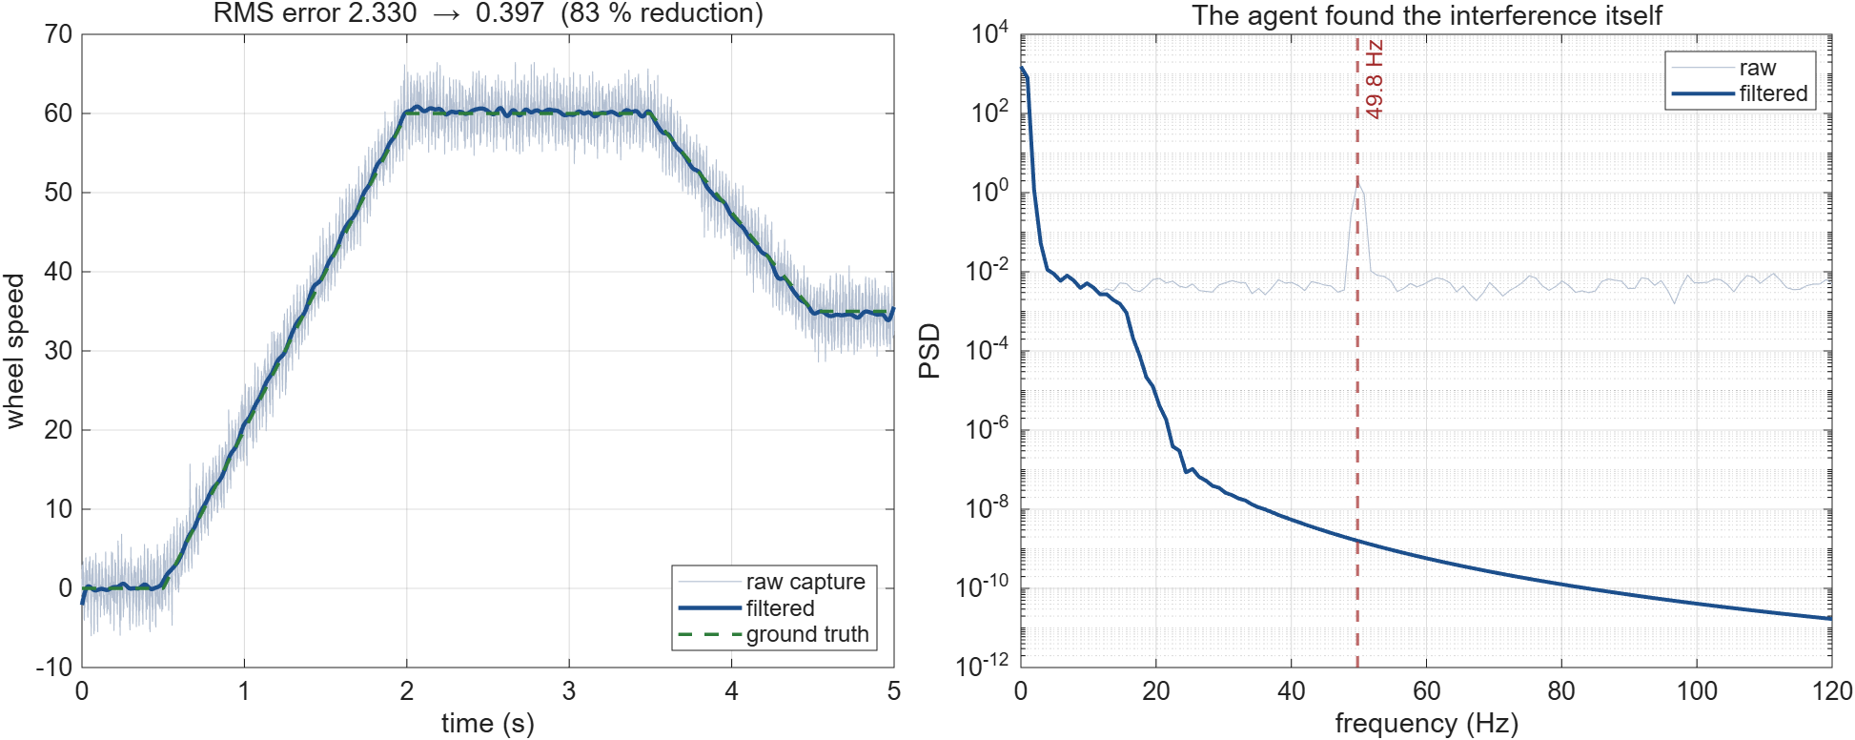
If time · the result — 83 % less error
IF TIME
It read the spectrum first, then designed to what it found — it did not guess a filter
The 49.8 Hz spike is gone and the low-frequency signal is intact — zero-phase filtering, so the timing of the brake event is preserved.
Run /usage now — and again at every checkpoint.
Techsource Systems · Agentic AI for MATLAB & Simulink
34

Slide 30
If time · the three prompts that got there
IF TIME
~4 min · three small prompts · the everyday task that eats research time
PROMPTS — ONE AT A TIME
1 Load wheel_speed_raw.mat. Before you filter
anything, tell me what is in this signal:
sample rate, spectrum, and what is
contaminating it.
2 Design a filter to remove what you found.
Ask me about passband and phase distortion
before you design anything.
3 Apply it. Show me before/after, and how much
closer we now are to true_speed.
Watch for
It identifies the interference itself: 49.8 Hz, from the spectrum
The skill makes it ask about phase — a DSP colleague's question
It chooses filtfilt for zero phase distortion, and can justify why
Runs in 0.46 s — the whole analysis is faster than opening the file by hand
RESULT: 49.8 Hz interference + broadband noise removed · RMS error against ground truth 2.330 → 0.397 · an 83 % reduction, in 0.46 s
MCP TOOLS CALLED
SKILLS TRIGGERED
PRODUCTS REQUIRED
evaluate_matlab_code run_matlab_file
matlab-design-digital-filter matlab-prepare-signal-data
SIGNAL PROCESSING TOOLBOX
Same pattern for CAN logs, dyno traces, driver-monitoring streams — anything you currently clean by hand.
Run /usage now — and again at every checkpoint.
Techsource Systems · Agentic AI for MATLAB & Simulink
35

Slide 31
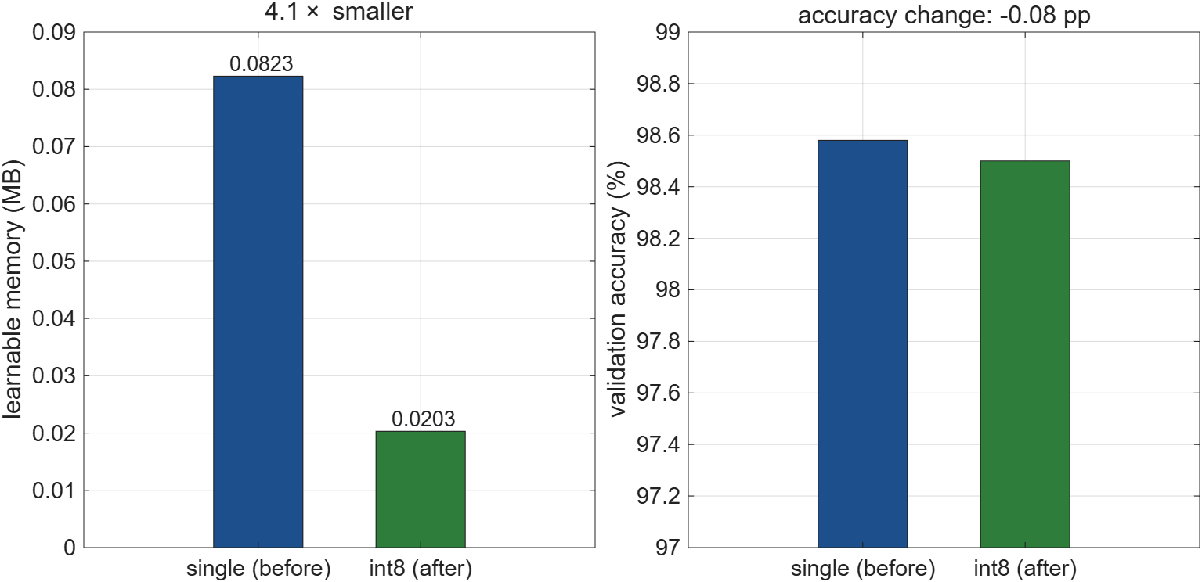
If time · the trade, stated as numbers
IF TIME
This is the conversation an embedded team needs: how much accuracy for how much memory
4.1× smaller for 0.08 percentage points. On a real perception network for a vehicle HPC, that is the difference between fits and does not fit.
Run /usage now — and again at every checkpoint.
Techsource Systems · Agentic AI for MATLAB & Simulink
36

Slide 32
If time · the prompt that made the trade
IF TIME
~4 min · ANCL Thrust B, verbatim: compressing AI models for vehicle HPCs
PROMPT — COPY & PASTE
Load digit_cnn.mat - a network I trained
earlier. Report its validation accuracy and its
learnable parameter memory.
Then quantize it to int8 and report the same
two numbers, so I can see the trade. Do not
retrain it.
Watch for
Calibration then quantization — it explains the step, not just runs it
The trade is stated as numbers you can argue with, not a claim
Same workflow scales to a real perception network for an HPC target
MEASURED ON THIS MACHINE
BEFORE
AFTER (int8)
CHANGE
Accuracy
98.58 %
98.50 %
−0.08 pp
Learnable memory
0.0823 MB
0.0203 MB
4.1× smaller
PRESENTER WARNING — never train live. Training this network blew the MCP tool timeout in rehearsal. Pre-train it; the live step is the 19 s quantization only.
4× smaller for 0.08 percentage points of accuracy — that is the conversation an embedded team actually needs to have.
Run /usage now — and again at every checkpoint.
Techsource Systems · Agentic AI for MATLAB & Simulink
37

Slide 33
Safety-critical · the prompt and what it found
SAFETY CRITICAL
~5 min · MISRA C:2012 + Bug Finder on production-style ECU C
PROMPT — COPY & PASTE
Run Polyspace on ecu_src/speed_monitor.c with
MISRA C:2012 and Bug Finder defects enabled.
Explain each finding in plain English, worst
first. Then fix them one at a time, re-running
after each fix to prove it is actually gone.
Watch for
It reports proof, not opinion: “Expected i is [0..3], actual is [0..4]”
It distinguishes Mandatory from Advisory MISRA rules
Each fix is re-verified — the finding count drops in front of you
WHAT IT FOUND IN 44 LINES OF C — 10 FINDINGS
HIGH
Array access out of bounds
loop runs i = 0..4 over a 4-element array
HIGH
Integer division by zero
divisor is initialised to 0 and never changed
HIGH
Non-initialised variable read
limit is compared before it is ever set
MANDATORY
MISRA C:2012 9.1
object read before it has been set
REQUIRED
MISRA C:2012 18.1 · Dir 4.1
pointer arithmetic outside the array; run-time failure
This is the evidence an OEM asks for — and the agent produces it, explains it, fixes it, and proves the fix.
Run /usage now — and again at every checkpoint.
Techsource Systems · Agentic AI for MATLAB & Simulink
39

Slide 34
Safety-critical code — proof, not opinion
SAFETY CRITICAL
The closing demo: MISRA C:2012 and proof-based defect analysis on ECU C
44
10
3
1
lines of ECU C — the kind that ships
findings from MISRA + Bug Finder
high impact — provable run-time faults
Mandatory MISRA rule — not negotiable
!
It compiled. It looked fine.
✓
Proof, not a heuristic
Mandatory vs Advisory
The file builds without a warning and reads cleanly in review.
An out-of-bounds write is a field failure, not a compiler message.
Nothing in the toolchain was going to tell you.
“Expected values: i is [0..3]. Actual values: i is [0..4].”
Polyspace proves the range across every path — it does not sample.
That is an artefact an auditor will accept.
MISRA separates what you must fix from what you may argue.
The agent keeps that distinction and tells you which is which.
Then it fixes them one at a time, re-running after each.
SAME LOOP AS EVERY OTHER DEMO TODAY
Find → explain in plain English → fix one at a time → re-run to prove it is gone. The agent runs the loop; you decide what is acceptable.
In automotive electronics, MISRA compliance and defect evidence are contractual deliverables — not internal hygiene.
Techsource Systems · Agentic AI for MATLAB & Simulink
38
Notes:
This is the closing demo, and for an automotive electronics lab it is the one with the sharpest commercial edge.
Lead with the numbers on this slide before you run anything: 44 lines, 10 findings, 3 of them high impact, 0 left at the end. Then run the prompt on the next slide.
The word to keep saying is SAFETY-CRITICAL. Anything that goes into a vehicle carries a MISRA C:2012 obligation and an ISO 26262 argument behind it. Static proof is how that argument gets made, and Polyspace produces the artefact an auditor will accept.
Position yourself carefully here: you are not claiming to know their safety case. You are showing them the tool that produces the evidence their safety case needs.

Slide 35
What you just watched
RECAP
An opening demo, a main demo, and safety-critical C — every claim backed by something that ran
D
Trained a model that predicts remaining useful life
RMSE ~20 cycles
A
Built and tidied a Simscape plant + controller
caught it using a 0.08 W motor
A
Turned a requirement into a failing test, then made it pass
32.7 % → 3.4 % overshoot
S
Found three high-impact defects in safety-critical C
with proof, not opinion
·
Removed 49.8 Hz interference from a sensor capture
83 % less error
·
Compressed a network to fit vehicle hardware
4.1× smaller
What did not happen
Show /usage one more time
Nobody pasted a model into a chat window
Nothing was accepted because it sounded right
Compare it against the number you wrote down at the start
That is a full afternoon of engineering, executed and verified
You still own the results. The same review and validation apply to agent-authored work as to your own.
Techsource Systems · Agentic AI for MATLAB & Simulink
40
Notes:
Close the loop on /usage here - this is the money slide for the 'it is cheaper than you think' argument.

Slide 36
What you just watched
RECAP
An opening demo, a main demo, and safety-critical C — every claim backed by something that ran
D
Trained a model that predicts remaining useful life
RMSE ~20 cycles
A
Built a plant + controller, then made a requirement pass
32.7 % → 3.4 % overshoot
S
Found three high-impact defects in safety-critical C
with proof, not opinion
What did not happen
Show /usage one more time
Nobody pasted a model into a chat window
Nothing was accepted because it sounded right
Compare it against the number you wrote down at the start
That is a full afternoon of engineering, executed and verified
You still own the results. The same review and validation apply to agent-authored work as to your own.
Techsource Systems · Agentic AI for MATLAB & Simulink
41
Notes:
Close the loop on /usage here - this is the money slide for the 'it is cheaper than you think' argument.

Slide 37
What needs a toolbox?
WRAP
Start on base. Add depth when the workflow demands it.
Build, edit and wire models (model_edit)
BASE SIMULINK
Simulate and log to the Data Inspector
BASE SIMULINK
Inspect models, diagnostics, parameters
BASE SIMULINK
Live-script documentation and reports
BASE MATLAB
Main demo A — physical DC motor model
Simscape + Simscape Electrical
Main demo A — managed / Gherkin test cases
Simulink Test (assertions work on base)
Signal filtering — filter design
Signal Processing Toolbox
RUL + compression — train, then quantize
Deep Learning Toolbox
Safety-critical C — MISRA and defect analysis
Polyspace Bug Finder
Architecture views (System Composer)
System Composer
Start on base — the core method needs no toolbox at all. And detect_matlab_toolboxes tells the agent exactly what you have.
Verified on the presenter's machine: R2026a Update 4 with the full product suite installed.
Techsource Systems · Agentic AI for MATLAB & Simulink
42

Slide 38
What this changes for your research
Think of it as a very fast lab technician — not a co-author
You
The agent
You
decide what is worth asking
sets up the rig, runs the repeats, logs everything
judge what the result means
A good lab technician never designs your experiment — and never decides what the data means.
Throughput
Reproducibility
✓
Evidence
The tedious 70 % — cleaning, plotting, boilerplate, harnesses — stops eating your week.
The analysis behind Figure 4 still runs a year later, on one command.
Requirements become tests. Claims arrive with artifacts attached.
You keep the two ends that need judgement. The agent takes the middle that never did.
Techsource Systems · Agentic AI for MATLAB & Simulink
13
Notes:
Say it plainly: nobody is asking you to trust the AI with the science. You still frame the question and you still interpret the answer. What changes is that the plumbing between those two points stops costing you a week. If someone pushes back on rigour, this is the slide to return to.

Slide 39
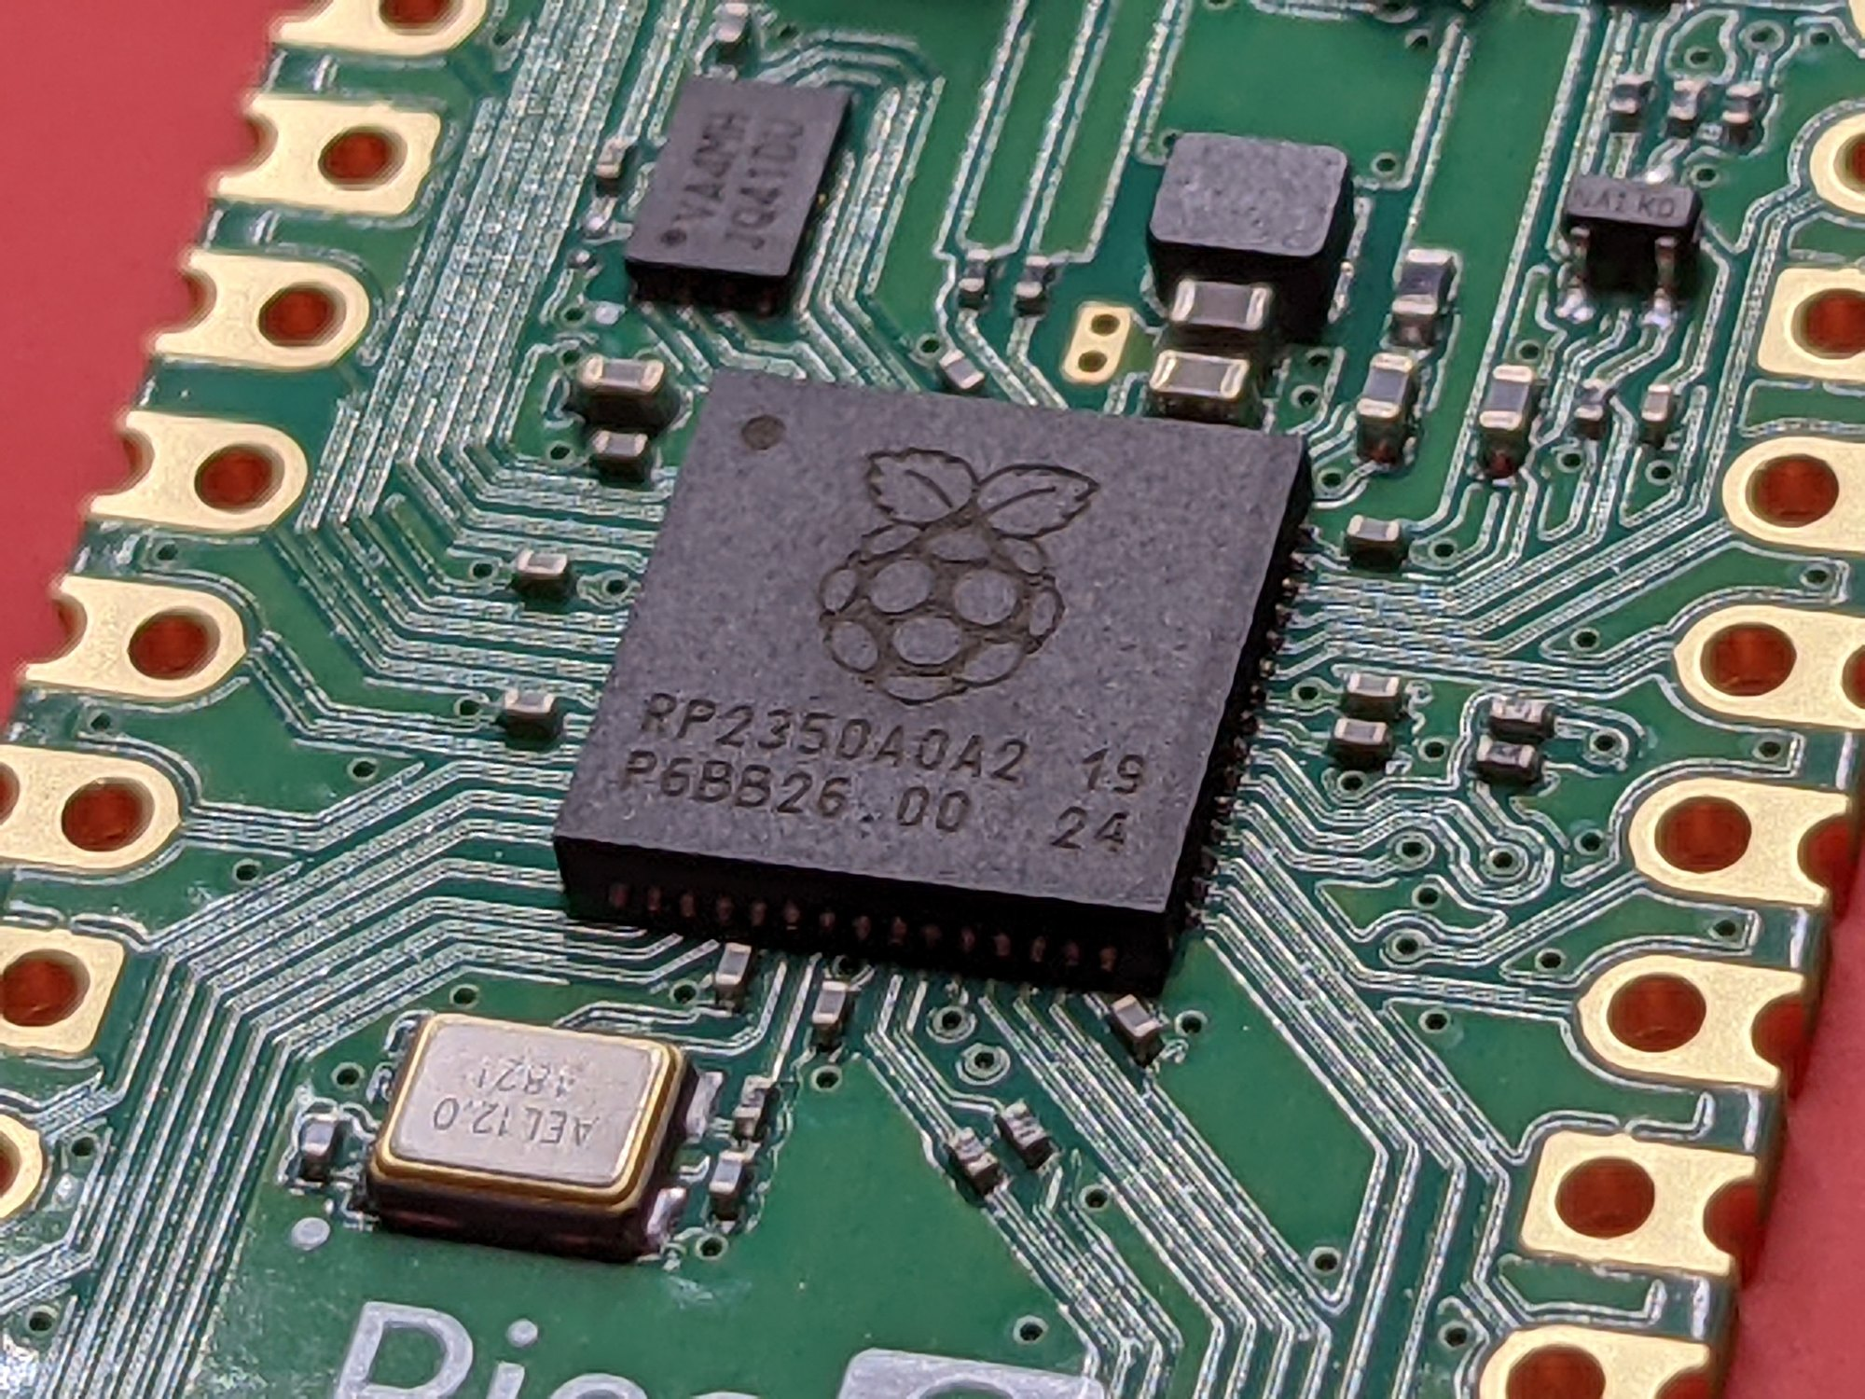

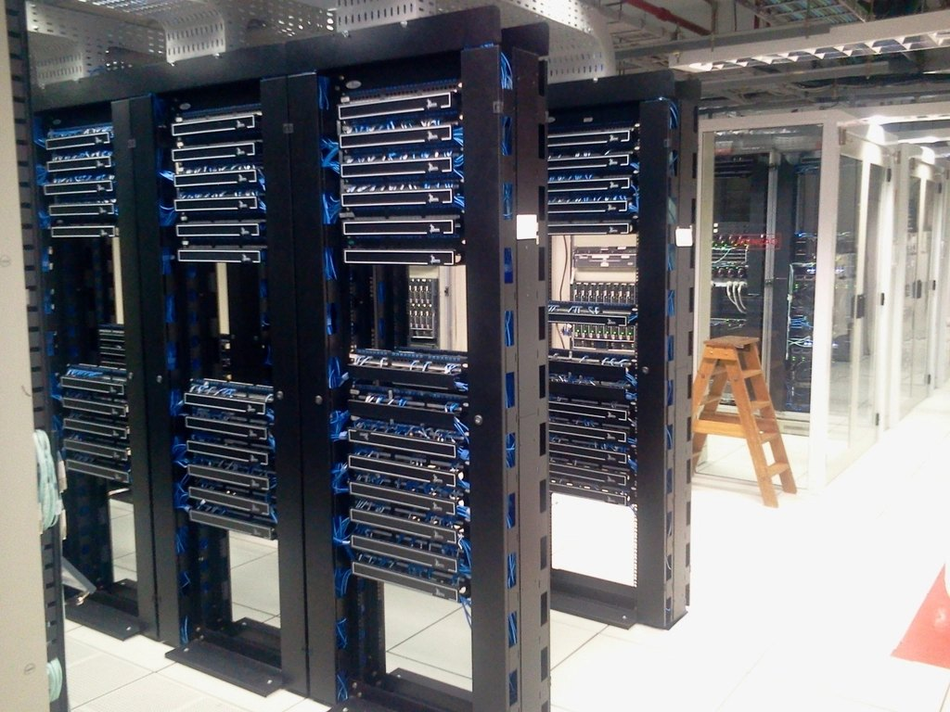
Where this lands in ANCL's three thrusts
Three pillars, and the demo that speaks to each one
THRUST A
THRUST B
THRUST C
Sustainability & novel materials
Artificial intelligence
Connectivity & security
Fit actuator and material models to bench data.
Compress a network until it fits the vehicle HPC.
Prove automotive C is MISRA-clean before it ships.
the signal-filtering pattern
the opening demo, today
the closing demo, today
You know this work far better than I do. My job today is the tooling — and the tooling removes friction between the idea and the result.
Thrusts per ntu.edu.sg/ancl · 131 papers, 93 patents · photos CC0
Techsource Systems · Agentic AI for MATLAB & Simulink
14
Notes:
The fuller mapping, if anyone asks. A - parameter fitting for dielectric elastomers and piezo devices, Simscape and multibody models of haptic and display assemblies, DOE sweeps, symbolic and PDE material models. B - network compression and quantisation for HPC targets, sensor-fusion and driver-monitoring pipelines, reinforcement learning and control policy loops, deployment via GPU Coder and Embedded Coder. C - static analysis and MISRA compliance, OTFS and joint radar-comms waveform and channel simulation, test-harness and edge-case generation, automotive Ethernet and V2X link budgets.

Slide 40
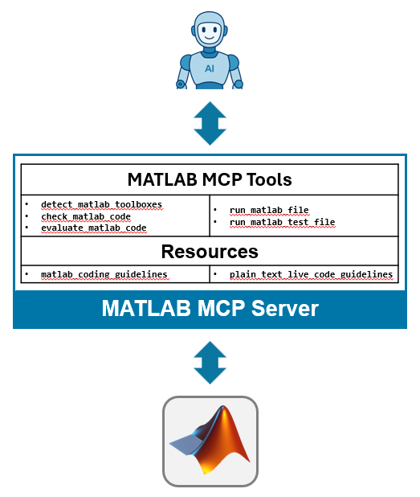
MATLAB MCP Server — the local bridge
A local server that connects your AI agent to the MATLAB you already licence
What it is
A local MCP server that connects AI agents to a locally licensed MATLAB, enabling intelligent automation and code execution.
$
No additional licence required
Just connect and go. It runs on the MATLAB licence your campus agreement already provides.
Privacy preserved by local execution
The server and MATLAB both run on your machine. Code, models and data never leave it.
New session, or the one you have open
It can start a fresh MATLAB or attach to your existing session — your workspace, your open model.
Diagram: MathWorks · “Agentic AI Workflows with MATLAB and Simulink”
github.com/matlab/matlab-mcp-server — R2021a or later, Windows, macOS and Linux.
Techsource Systems · Agentic AI for MATLAB & Simulink
15

Slide 41
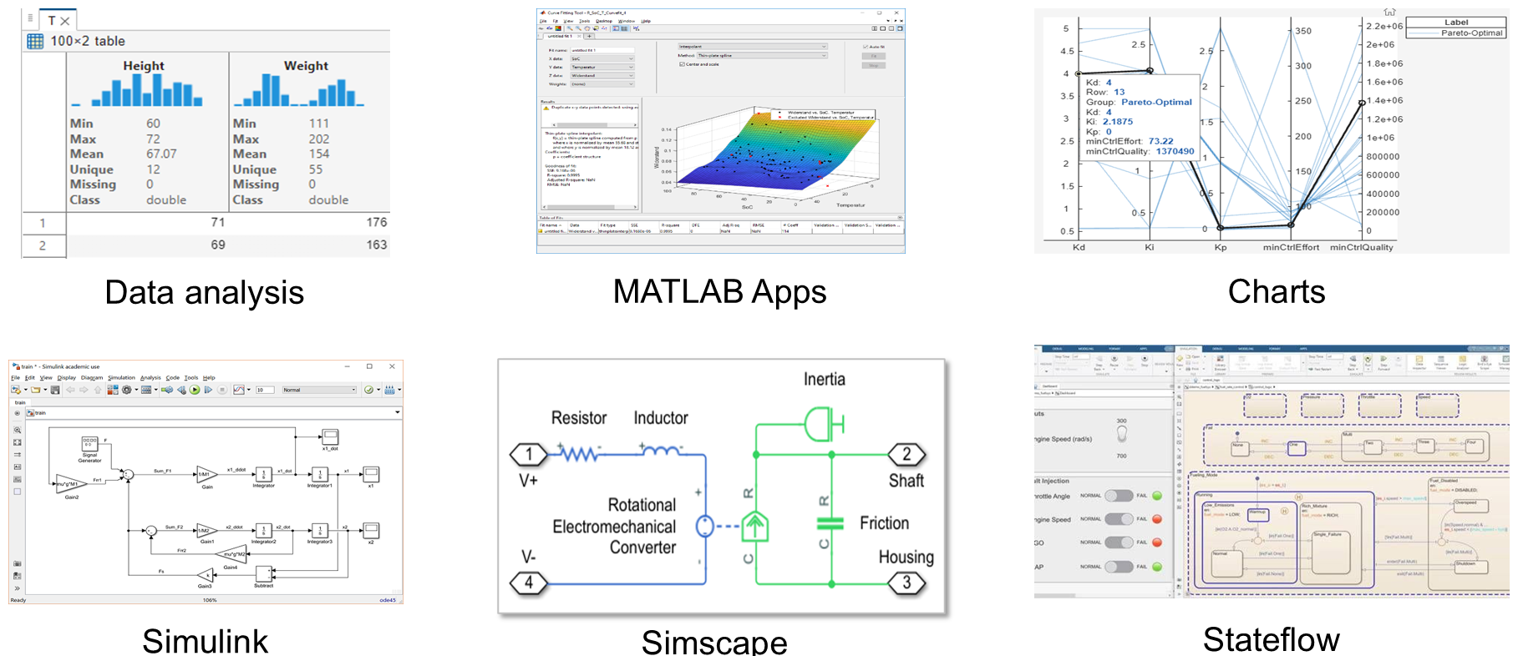
Maintain oversight — in an interactive environment
PART 3
The agent works inside tools you can open, inspect and argue with
Diagram: MathWorks · “Agentic AI Workflows with MATLAB and Simulink”
Data analysis · apps · charts · Simulink · Simscape · Stateflow — every one of them something you can inspect by hand.
Techsource Systems · Agentic AI for MATLAB & Simulink
24

Slide 42
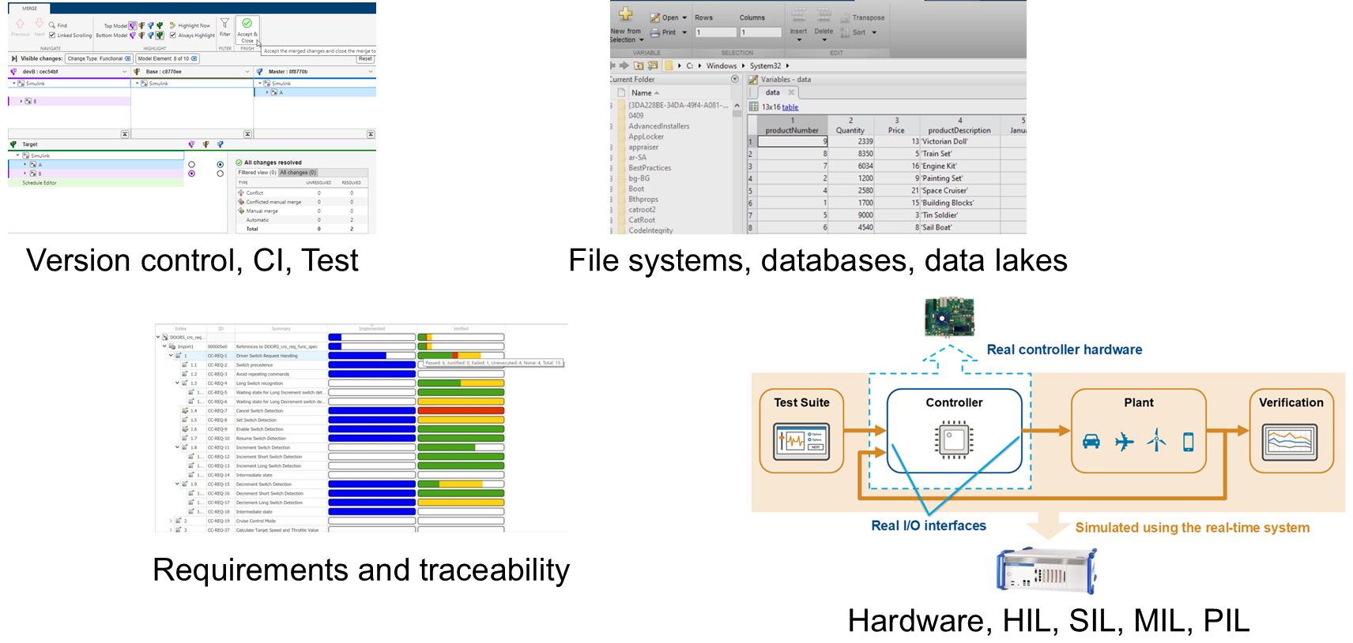
Maintain oversight — integrated with your systems
PART 3
Version control, requirements traceability and hardware testing are where the evidence lives
Diagram: MathWorks · “Agentic AI Workflows with MATLAB and Simulink”
This is the row that makes research transferable to an industry partner — traceability and HIL, not just a working script.
Techsource Systems · Agentic AI for MATLAB & Simulink
25

Slide 43

Image and data credits
WRAP
Everything in this deck is either generated here or openly licensed
Generated for this deck
Data sets
All six demo figures — produced by the rehearsal runs on the presenter's MATLAB R2026a
All diagrams — drawn as native PowerPoint shapes, editable
Simulink canvases — printed from the actual demo models
NASA C-MAPSS turbofan degradation data, via MathWorks “Data Sets for Deep Learning”
Digits data set, shipped with Deep Learning Toolbox
Wheel-speed capture — synthesised for this workshop (make_demo_data.m)
PHOTOGRAPHY — ALL CC0 / PUBLIC DOMAIN, VIA OPENVERSE
slide 5
slide 7 · Thrust A
slide 7 · Thrust B
slide 7 · Thrust C
Restaurant Kitchen
Michael Browning · CC0 · stocksnap
Macro photograph of the RP2350 microcontroll
Profpcde · CC0 · wikimedia
Luxury Car
Burst · CC0 · stocksnap
Free computer server room image
unknown · CC0 · rawpixel
No licence obligations attach to CC0 images — the credits are here because attribution is good practice, not because it is required.
Techsource Systems · Agentic AI for MATLAB & Simulink
44

Slide 44
Resources and next steps
WRAP
Links
Go deeper — instructor-led training
mathworks.com/products/matlab/agentic-ai
github.com/matlab/matlab-agentic-toolkit
github.com/matlab/simulink-agentic-toolkit
github.com/matlab/matlab-mcp-server
Ebook: Guide to Agentic AI with MATLAB and Simulink
Interactive explainer: “Agentic AI 101” on mathworks.com
Watch or star the repos — the toolkits ship updates weekly, independently of MATLAB releases
Today's session is the compressed preview of both
Available as private events for research groups, departments and corporate labs
THIS WEEK — PICK ONE
Hand the agent one model you already maintain and ask only for the read-only overview. No edits, no risk.
Or take one analysis you run by hand every month and ask for it as a live script you can re-run.
We can run a pilot with your group: your models, your standards, your machines — and a custom skill set for ANCL.
Deck built and verified on MATLAB R2026a Update 4 · every demo timing measured, not estimated · Sep 2026
Techsource Systems · Agentic AI for MATLAB & Simulink
43

Slide 45
Questions?
Koay Xian Cong · Application Engineer · Techsource Systems Pte Ltd
Ask about pilot setups, group training, and custom skills for your projects.
Which model or analysis would you hand to an agent first?
Techsource Systems · Agentic AI for MATLAB & Simulink
45

Slide 46
APPENDIX
Setting it up on your own machine
Six steps · verification on every platform · what to do when it breaks
~15 minutes, once
Runs on your MATLAB licence
Ask us if you get stuck
Techsource Systems · Agentic AI for MATLAB & Simulink
46
Notes:
Do not present these slides unless someone asks, or unless you have time left. They exist so the deck is a complete handout.

Slide 47
First-time setup — the whole path on one slide
APPENDIX
Six steps, ~15 minutes. Screenshots for each step follow.
1
Download
2
Open it
3
Install
agenticToolkitInstaller.mltbx from GitHub Releases
installs the Setup add-on into MATLAB
setupAgenticToolkit("install") · pick MATLAB / Simulink / Both
4
Configure
5
Share
6
Verify
pick your agents · skill groups · global or project
shareMATLABSession() (or satk_initialize) in the MATLAB you want the agent to use
in Claude Code (terminal or Desktop) / Codex: tools listed? then the verify prompt
Where people get stuck: step 5 (session not shared) and step 6 (agent not restarted). Both are 10-second fixes — see the rescue slides.
Follow along with the printed First-Time Setup & Rescue Card in your workshop pack.
Techsource Systems · Agentic AI for MATLAB & Simulink
47

Slide 48
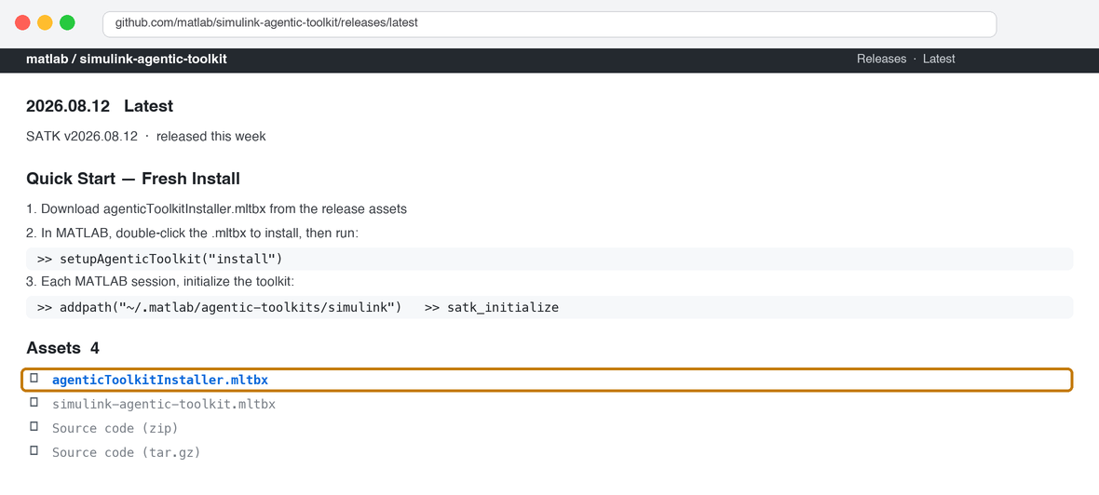
Step 1–2 · Download the installer from GitHub
SETUP 1/7
github.com/matlab/simulink-agentic-toolkit → Releases → Assets
1
Open the Releases page
github.com/matlab/simulink-agentic-toolkit/releases/latest — no GitHub account needed. Ignore the source-code zips.
2
Download agenticToolkitInstaller.mltbx
Under Assets. It's the same installer for the MATLAB toolkit, so you only ever need this one file.
3
Open the .mltbx
Double-click it (or drag into MATLAB). MATLAB's Add-On Manager installs "MathWorks Agentic Toolkit Setup" — click Install if asked. Nothing else is downloaded yet.
Behind a proxy or offline? setupAgenticToolkit supports Offline=true with local artifact paths — see Configuration_and_Troubleshooting.md in the toolkit repo.
GitHub Releases page for the Simulink Agentic Toolkit (release 2026.08.12). One installer covers BOTH toolkits.
Techsource Systems · Agentic AI for MATLAB & Simulink
48

Slide 49
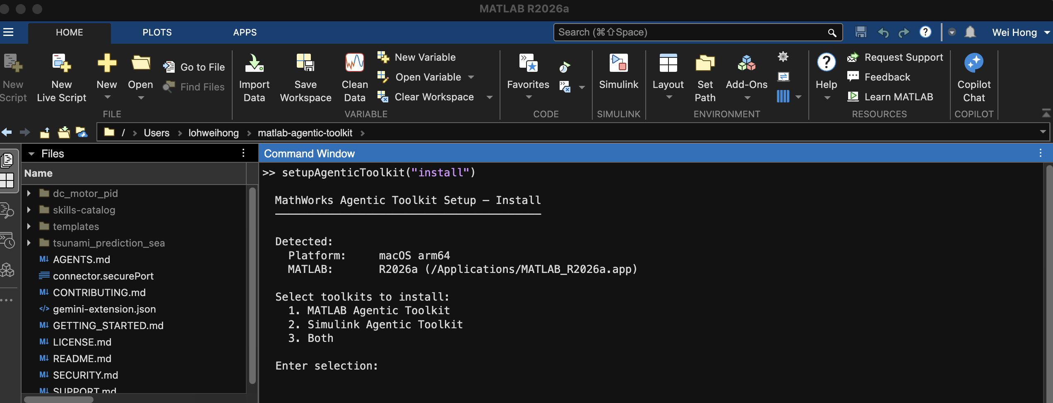
Step 3 · Run the installer in MATLAB
SETUP 2/7
Command Window → setupAgenticToolkit("install") — the first prompt
1
Type the command
setupAgenticToolkit("install") — the add-on put it on your path. If MATLAB says "Unrecognized function", the .mltbx did not install: reopen it.
2
Check the Detected block
It should name the MATLAB you want agents to use. Wrong one? Close the others and re-run, or pass Prompt=false with explicit options later.
3
Choose 3 — Both
Even if today is MATLAB-only. Simulink skills cost nothing until a model task triggers them, and you won't re-run this later.
Real MATLAB R2026a session — the installer detects your platform and MATLAB, then asks which toolkits to install.
Also available: setupAgenticToolkit("status") — read-only, shows what is installed and configured. Your first diagnostic when anything looks off.
Techsource Systems · Agentic AI for MATLAB & Simulink
49

Slide 50
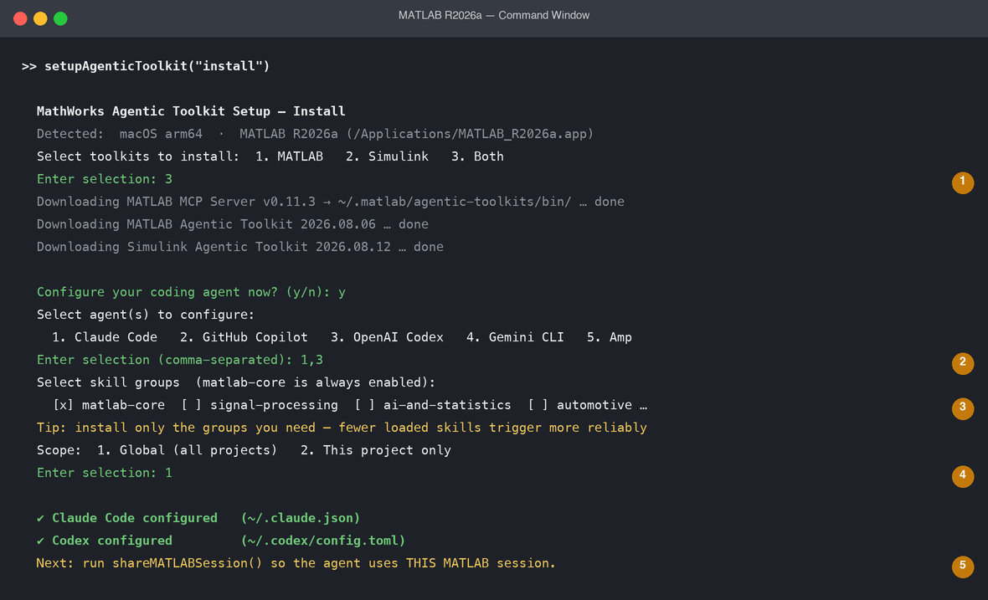
Step 4 · Configure your agents — the prompts you'll see
SETUP 3/7
One pass writes the MCP config for every agent you pick
1
Toolkits → downloads
MCP Server binary + both toolkits land in ~/.matlab/agentic-toolkits/. Needs internet once.
2
Pick agents
Comma-separated. Only agents installed on this machine will actually be reachable — Claude Code and Codex share nothing, so pick both if you use both.
3
Pick skill groups
matlab-core is always on. Fewer groups = more reliable triggering. Add domains later with "configure".
4
Scope
Global = every project (start here). Project = writes config into the current folder — good for teams.
5
Done → share the session
Config files written per agent. Next slide: make the agent use YOUR MATLAB.
Prompt sequence per the installer docs (interactive mode). Numbers match the callouts on the right.
Techsource Systems · Agentic AI for MATLAB & Simulink
50

Slide 51
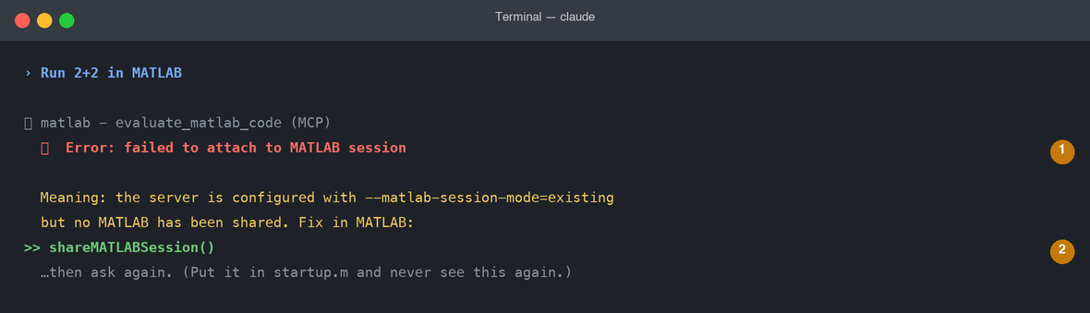
Step 5 · Point the agent at YOUR MATLAB session
SETUP 4/7
The step everyone skips — and the #1 cause of "failed to attach to MATLAB session"
1
Why it happens
The installer configures the server with --matlab-session-mode=existing (or auto). "Existing" means: attach to a MATLAB that has been SHARED. Open ≠ shared.
2
The fix — every session
addpath("~/.matlab/agentic-toolkits/simulink") then satk_initialize — shares the session AND validates the install. Or plain shareMATLABSession().
3
Make it permanent
Real error from this machine: agent configured, MATLAB open — but not shared.
Put it in startup.m (type edit startup.m). Then every MATLAB you launch is agent-ready. Multiple MATLABs open? The most recently shared one wins.
STARTUP.M — PASTE ONCE
addpath("~/.matlab/agentic-toolkits/simulink")
satk_initialize
% shares this MATLAB with your agent + validates the toolkit
No shared session → the server may launch a NEW hidden MATLAB (mode auto) — your workspace and open model won't be there. Share first.
Techsource Systems · Agentic AI for MATLAB & Simulink
51

Slide 52
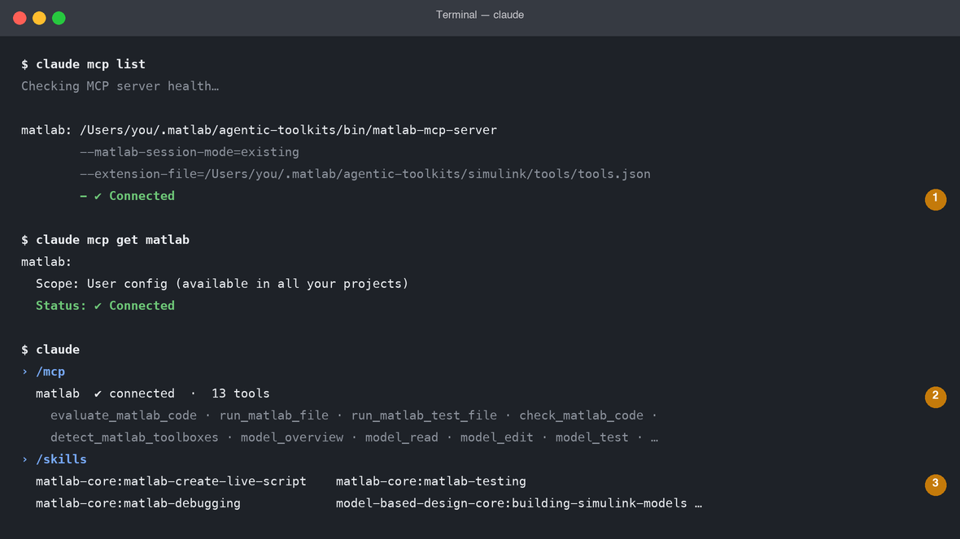
Step 6a · Verify in Claude Code
SETUP 5/7
Three checks, 60 seconds — this is what "it worked" looks like
1
claude mcp list → ✔ Connected
From any terminal, before launching Claude. Not listed? Config wasn't written — re-run setupAgenticToolkit("configure"). Listed but ✘? MATLAB path or Gatekeeper — see rescue.
2
/mcp inside Claude Code
Shows the matlab server and its tool count: 5 MATLAB tools (+8 model tools if Simulink toolkit installed). Restart Claude Code if you configured while it was open.
3
/skills lists MATLAB skills
matlab-core:… entries prove the plugin installed. Missing? claude plugin install matlab-core@matlab-agentic-toolkit
Real output from this machine (paths shortened). Config lives in ~/.claude.json, written by setupAgenticToolkit via claude mcp add.
Prefer the Claude Desktop app? Next slide — same config, same checks. Then the verify prompt.
Techsource Systems · Agentic AI for MATLAB & Simulink
52

Slide 53
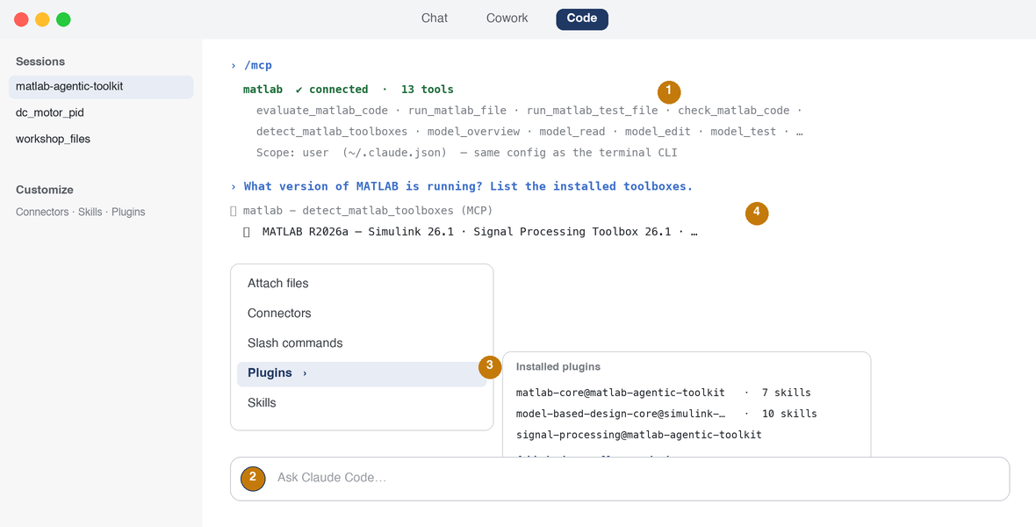
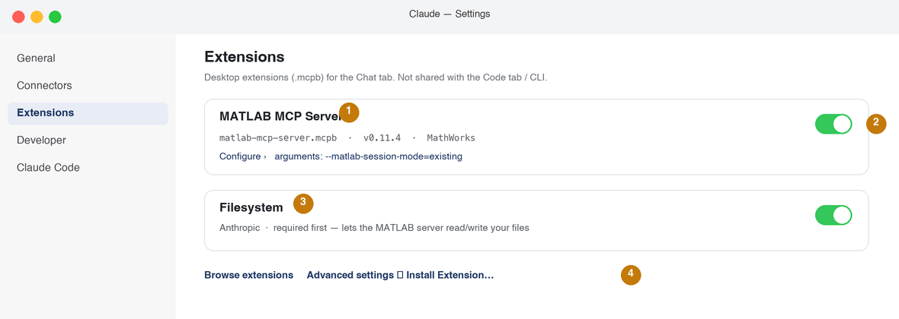
Step 6b · Verify in the Claude Desktop app
SETUP 6/7
Two tabs, two different worlds — the Code tab IS Claude Code; the Chat tab needs its own extension
1
Code tab → /mcp shows matlab
Claude Code Desktop runs the same engine and reads the same ~/.claude.json as the terminal CLI — so setupAgenticToolkit already configured it. Nothing extra to install.
2
+ button → Plugins
Lists installed plugins and their skills (matlab-core, model-based-design-core, …). Missing? Add plugin → matlab-agentic-toolkit marketplace, or run the CLI: claude plugin install matlab-core@matlab-agentic-toolkit
3
Same skills, same slash commands
Type / in the prompt box: /matlab-testing, /matlab-debugging… appear exactly as in the terminal. Personal skills come from ~/.claude/skills/.
4
Verify prompt — look for the tool call
Same pass criterion: a matlab · detect_matlab_toolboxes line, then your MATLAB's answer. Configured while the app was open? Quit + reopen.
CHAT TAB (CLAUDE DESKTOP, NOT CLAUDE CODE) — DIFFERENT PATH
Which one am I in?
The Chat tab does not read ~/.claude.json. To use MATLAB from a plain Claude chat: Settings → Extensions → install Anthropic's Filesystem extension first, then download matlab-mcp-server.mcpb from github.com/matlab/matlab-mcp-server/releases and double-click it → Install. Configure arguments (e.g. --matlab-session-mode=existing) under Settings → Extensions → Configure. Skills do not apply in Chat — this is MCP tools only.
Code tab (or the claude terminal command) → agentic coding, skills, /mcp — this is what the workshop uses
Chat tab → conversational Claude with desktop extensions; MATLAB via .mcpb, no skills
Rule of thumb: if you can type /mcp, you're in Claude Code.
For the workshop, use the Code tab (or the terminal) — the setup you just did already covers it.
Techsource Systems · Agentic AI for MATLAB & Simulink
53

Slide 54
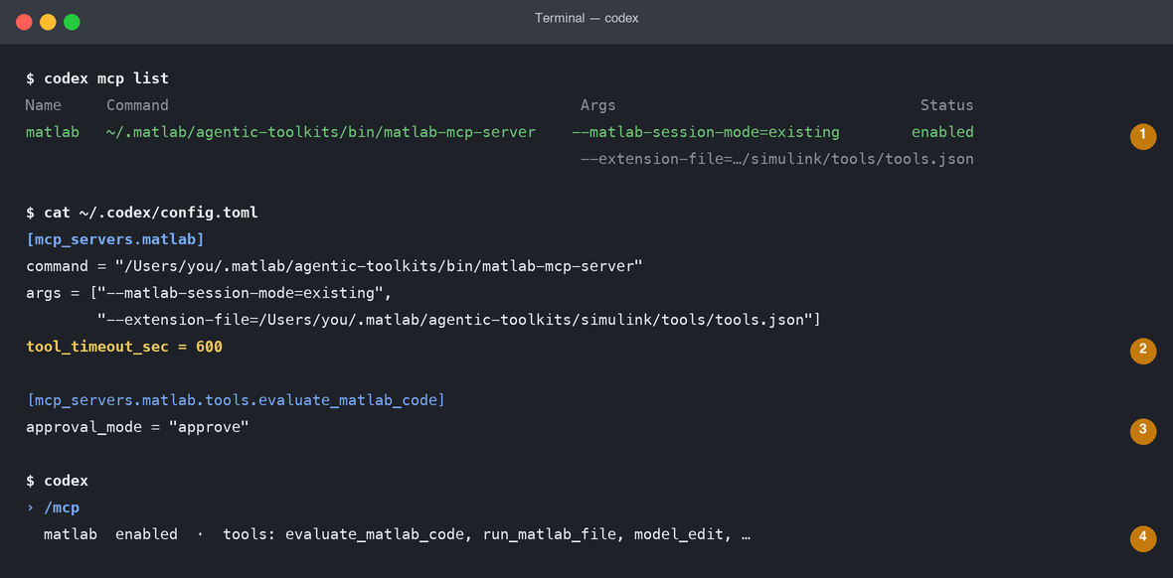
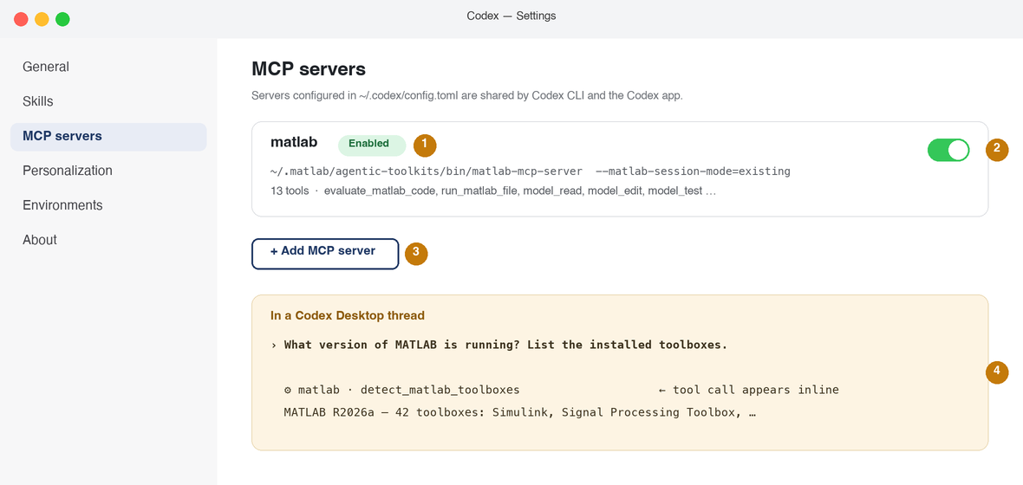
Step 6c · Verify in Codex — CLI and Desktop app
SETUP 7/7
One config file (~/.codex/config.toml) serves both the terminal CLI and the Codex desktop app
1
codex mcp list → matlab enabled
Terminal check. Missing? Re-run configure with Agents="codex", or paste the [mcp_servers.matlab] block from templates/codex-mcp.json.
2
tool_timeout_sec = 600
Codex's default timeout is too short for test suites and simulations — the installer sets 600. If long tasks time out, raise it. Windows + Simulink: add env_vars = ['WINDIR'].
3
approval_mode = "approve"
Codex asks before running MATLAB code — human-in-the-loop by default. Keep it for the workshop.
4
/mcp — and the skills
/mcp confirms server + tools. Skills: CLI and the Codex app both read ~/.agents/skills/ symlinks — ls ~/.agents/skills | grep matlab. In the app: Settings → Skills lists them. Missing? Re-run configure with Agents="codex".
CODEX DESKTOP APP — SAME CONFIG, NO EXTRA SETUP
1 Settings → MCP servers — the same matlab entry appears (the app reads ~/.codex/config.toml)
2 Toggle it ON — green means the server launches on demand
3 “+ Add MCP server” is only needed if you skipped the installer’s Codex step
4 Settings → Skills shows the MATLAB skills (from ~/.agents/skills/) — no skills there = Fix C
5 Open a new thread and paste the verify prompt — the tool call appears inline
Quit + reopen the app after configuring. CLI and app never disagree — one file.
Same server, same skills, same verify prompt — CLI or Desktop.
Techsource Systems · Agentic AI for MATLAB & Simulink
54

Slide 55
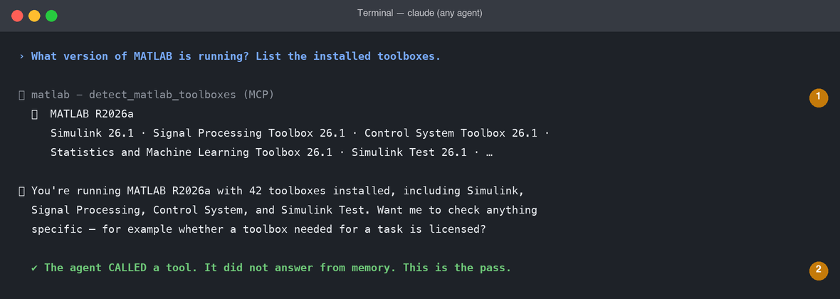
The pass criterion: the agent calls a tool
VERIFY
One prompt tells you the whole chain works — agent → MCP → MATLAB → back
1
Look for the tool call line
⏺ matlab - detect_matlab_toolboxes (MCP). If the agent answers with a version but no tool call, it guessed — the MCP link is NOT working.
2
The answer matches your MATLAB
Release and toolbox list should be yours. If it names a different release, the server attached to a different MATLAB — check setupAgenticToolkit("status") and which session is shared.
PASTE THIS — WORKS IN EVERY AGENT · (Claude Code shown above; identical in Codex)
What version of MATLAB is running? List the installed toolboxes.
Then: “Give me an overview of the slrgex_fuelsys model.” (ships with MATLAB) → the agent must call model_overview, not describe it from memory.
Green = tool called + your MATLAB's answer. Anything else → rescue slides.
Techsource Systems · Agentic AI for MATLAB & Simulink
55

Slide 56
Register on YOUR platform — same server, same skills
APPENDIX
The toolkit is agent-agnostic: templates ship for every major MCP client
Claude Code
VS Code · GitHub Copilot
Automatic via the setup skill
.mcp.json + skills registered
Confirm with /skills
templates/vscode-mcp.json
→ .vscode/mcp.json
Use agent mode; model tools appear in the picker
OpenAI Codex CLI
Gemini CLI
templates/codex-mcp.json
→ merge into ~/.codex/config.toml
AGENTS.md guides the session
templates/gemini-extension.json
→ gemini extensions install .
Skills exposed via the extension
One choice your organisation keeps: which LLM sits behind the agent — cloud frontier model or fully local.
Techsource Systems · Agentic AI for MATLAB & Simulink
56

Slide 57
Rescue · the 60-second diagnostic
RESCUE 1/4
Three questions locate the break — then jump to the matching fix
Q1
Does the agent list a matlab MCP server?
NO → agent–config problem
Fix A
claude mcp list · codex mcp list · /mcp
YES ↓
Q2
Tools listed — do calls succeed?
NO → server–MATLAB problem
Fix B
Ask: “Run 2+2 in MATLAB.”
YES ↓
Q3
Calls work — do skills trigger?
NO → skills problem
Fix C
/skills · ask a task and watch for the skill name
Before any of that: setupAgenticToolkit("status") in MATLAB — shows server version, MATLAB root, and which agents are configured. Nine times out of ten the answer is on that screen.
Restart the agent after ANY config change. Codex Desktop / Claude Desktop: quit and reopen the app. Nothing works? Fix D — read the logs.
Techsource Systems · Agentic AI for MATLAB & Simulink
57

Slide 58
Rescue · Fix A (no server) and Fix B (calls fail)
RESCUE 2/4
Fix A — the agent can't see the server
Fix B — server listed, but every call fails
Config not written / wrong agent picked
setupAgenticToolkit("configure", Agents="claude-code") or Agents="codex"
Agent was open during configure
Restart it. Claude Code re-reads ~/.claude.json on launch; Claude Desktop and Codex Desktop need quit + reopen.
matlab listed twice / tools duplicated
Server registered at both project (.mcp.json) and user (~/.claude.json) scope. claude mcp list shows the scope — remove one: claude mcp remove matlab -s project.
Where each agent's config lives (check the file exists and names matlab-mcp-server):
Claude Code ~/.claude.json (claude mcp get matlab)
Codex CLI+App ~/.codex/config.toml [mcp_servers.matlab]
Copilot VS Code user mcp.json → reload window
Gemini CLI ~/.gemini/settings.json
Manual fallback: copy templates/<agent>.json from the toolkit repo, fix the two paths, restart.
“failed to attach to MATLAB session” (most common)
In MATLAB: addpath("~/.matlab/agentic-toolkits/simulink"); satk_initialize — then retry.
macOS: “cannot be opened / not verified developer”
Gatekeeper quarantined the binary. Installer normally clears it; if not:
xattr -d com.apple.quarantine ~/.matlab/agentic-toolkits/bin/matlab-mcp-server
or System Settings → Privacy & Security → Allow Anyway.
Wrong MATLAB · a hidden second MATLAB · “my variables are missing”
auto mode starts a NEW headless MATLAB if none is shared — so you end up with two. Share yours first; setupAgenticToolkit("status") shows the root. Won't start? <root>/bin/matlab -nodesktop -r "disp(1),quit" — licence errors show here.
First call slow / times out
MATLAB launches on the FIRST tool call (30–60 s). Share a running MATLAB, or add --initialize-matlab-on-startup=true to the server args.
Codex: calls time out on long tasks
tool_timeout_sec = 600 (or more) under [mcp_servers.matlab].
Binary sanity check from any terminal: ~/.matlab/agentic-toolkits/bin/matlab-mcp-server --version → prints v0.11.x
Techsource Systems · Agentic AI for MATLAB & Simulink
58

Slide 59
Rescue · Fix C — skills don't trigger
RESCUE 3/4
Fix C — MCP works, but the agent ignores the skills
Prevention — do these once
Too many skills loaded → none trigger reliably
Keep only the groups you use: setupAgenticToolkit("configure") and deselect; or claude plugin remove <group>@matlab-agentic-toolkit.
Call the skill by name — always works
Claude Code: /matlab-testing · Codex & others: “Use the matlab-testing skill to …”
Skills missing entirely
Where skills live per surface — Claude Code CLI + Desktop: /skills or + → Plugins (plugin cache) · Codex CLI + Desktop: ~/.agents/skills/ symlinks (app: Settings → Skills) · Copilot/Gemini: ~/.agents/skills/. Reinstall: claude plugin install matlab-core@matlab-agentic-toolkit, or setupAgenticToolkit("configure").
startup.m: addpath + satk_initialize — no more attach errors
Install BOTH toolkits, but only the skill groups you need
Restart the agent after configure — make it a habit
Bookmark setupAgenticToolkit("status") and "update" (weekly releases)
Verify prompt after every update: does it CALL a tool?
Compliance: setupAgenticToolkit("configure", DisableTelemetry=true) opts out of anonymized usage data
Still stuck? Ask the agent itself — it can read its own config
“My MATLAB MCP server shows in claude mcp list but evaluate_matlab_code fails with ‘failed to attach’. Read ~/.claude.json, tell me the session mode, and walk me through the fix.” — agents are good at diagnosing their own plumbing once they can see the config file.
Official reference: Configuration_and_Troubleshooting.md in github.com/matlab/matlab-agentic-toolkit — plus the Rescue Card in your pack.
Techsource Systems · Agentic AI for MATLAB & Simulink
59

Slide 60
Rescue · Fix D — when nothing above works
RESCUE 4/4
Read the logs, turn up verbosity, and the platform-specific traps
Read the server log — this is what support will ask for
Useful server flags (edit args in ~/.claude.json · config.toml)
The MATLAB MCP Server writes a log folder per run in your OS temp dir:
macOS/Linux $TMPDIR/matlab-mcp-server-<id>/ · Windows %TEMP%\matlab-mcp-server-<id>\
Turn up detail and pin the location by adding to the server args (in your agent config):
--log-level=debug --log-folder=~/mcp-logs
Then reproduce once and read the newest file — MATLAB launch errors, licence failures, and attach failures are all spelled out there.
--matlab-root=<path> force which MATLAB (no /bin)
--matlab-session-mode=existing|auto|new
--initialize-matlab-on-startup=true start MATLAB at once
--initial-working-folder=<path> where MATLAB starts
--matlab-display-mode=nodesktop headless MATLAB
--disable-telemetry=true
Every flag also works as an env var: MW_MCP_SERVER_MATLAB_ROOT etc. — handy for locked-down configs.
Windows traps
Corporate network / proxy / after an update
JSON paths need double backslashes: C:\\Users\\me\\.matlab\\…\\matlab-mcp-server.exe
Binary blocked after download → PowerShell: Unblock-File matlab-mcp-server.exe
Config lives under %USERPROFILE% (~/.claude.json, ~/.codex/config.toml) and %APPDATA%\Code\User\mcp.json for Copilot
Codex + Simulink: env_vars = ['WINDIR'] — Codex strips env vars from MCP subprocesses
Download fails during install → grab matlab-mcp-server-<platform> from github.com/matlab/matlab-mcp-server/releases, drop it in ~/.matlab/agentic-toolkits/bin/, re-run setup
Fully offline: setupAgenticToolkit("install", Offline=true, MCPServerLocation=…, MATLABAgenticToolkitLocation=…)
After setupAgenticToolkit("update"): restart every agent, re-run the verify prompt. Update failing on slow links? Retry — 2026.08.12 raised the download timeout
Log + debug flag + the verify prompt reproduce 95% of tickets in one message to support — or to your agent.
Techsource Systems · Agentic AI for MATLAB & Simulink
60

Slide 61
Privacy, IP, and cost — the questions IT will ask
APPENDIX
The questions that decide whether this gets past a corporate lab's governance
YOUR MACHINE — NOTHING HERE LEAVES
prompts + code snippets
MATLAB & Simulink
your models
your data
the MCP server
the skills
your LLM provider
the one you already chose, under terms you already govern
No MathWorks cloud. Swap in a local open-weights model and even that arrow disappears.
$
No extra product licence
Air-gapped option
Licensing note
Published on GitHub under MathWorks licence terms. No additional product licence today — they run on the MATLAB licences you already have.
Pair a local open-weights model with DisableTelemetry=true and nothing leaves the system at all.
Personal automation: one user, one server, one MATLAB. A shared lab server that several people drive needs MathWorks approval — ask us.
The agentic setup adds no new IP exposure beyond the LLM relationship your organisation already governs.
Techsource Systems · Agentic AI for MATLAB & Simulink
61

